Slide 1
Key Databases for Graduate Level Biblical Studies and Theology Research

Slide 2
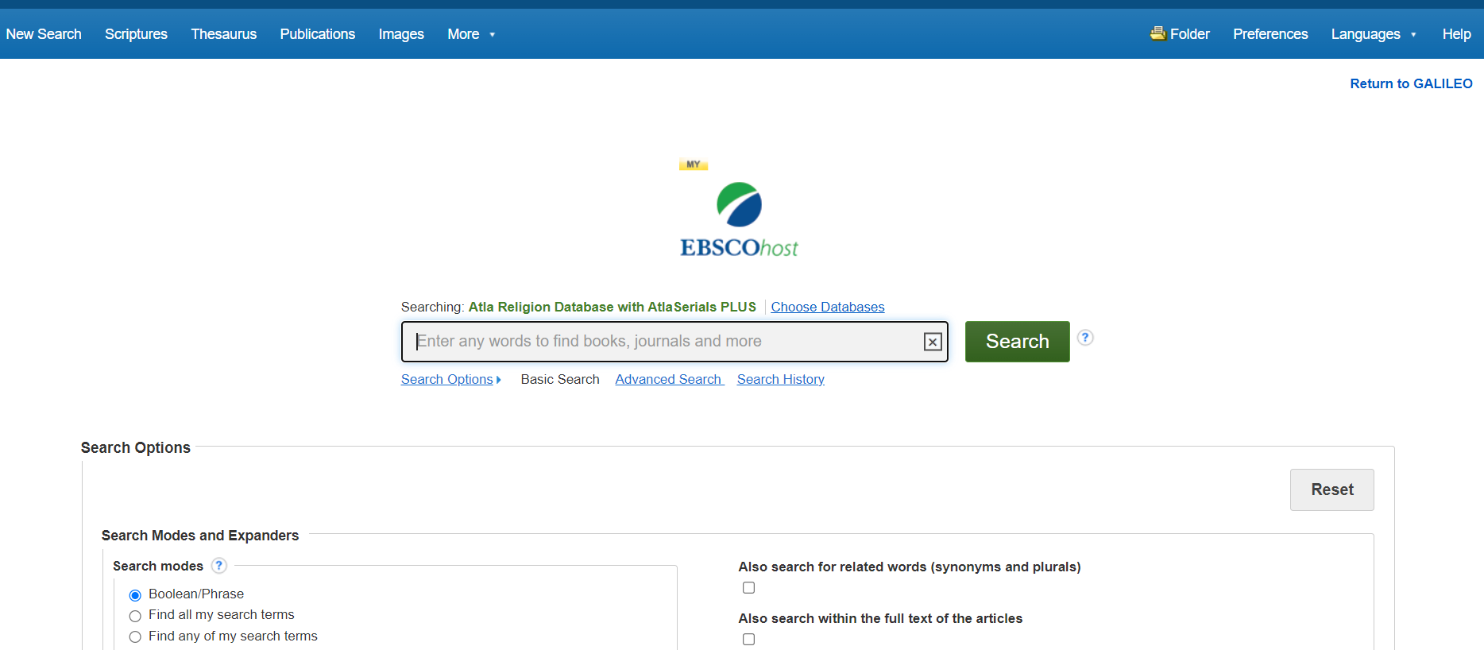
ATLA Religion Database

Slide 3
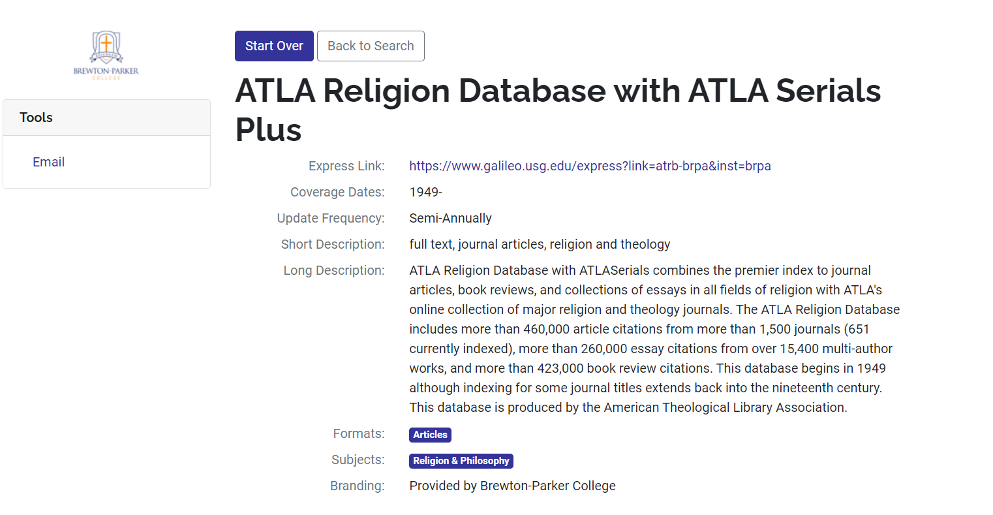
Information About the ATLA Database

Slide 4
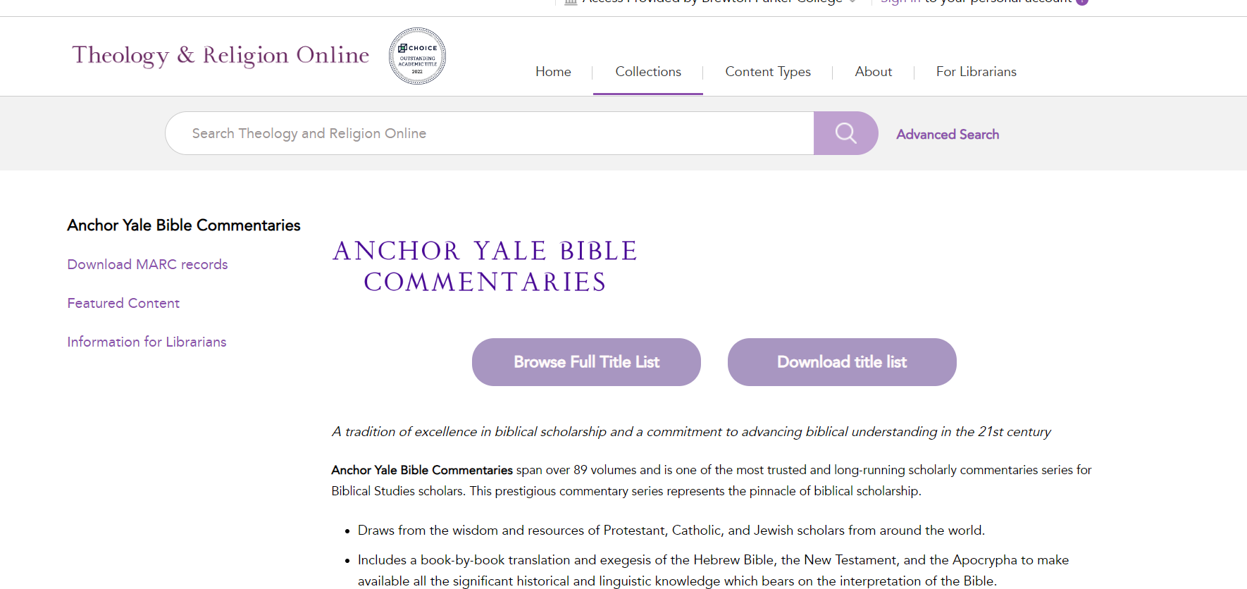
Anchor Yale Bible Commentaries

Slide 5
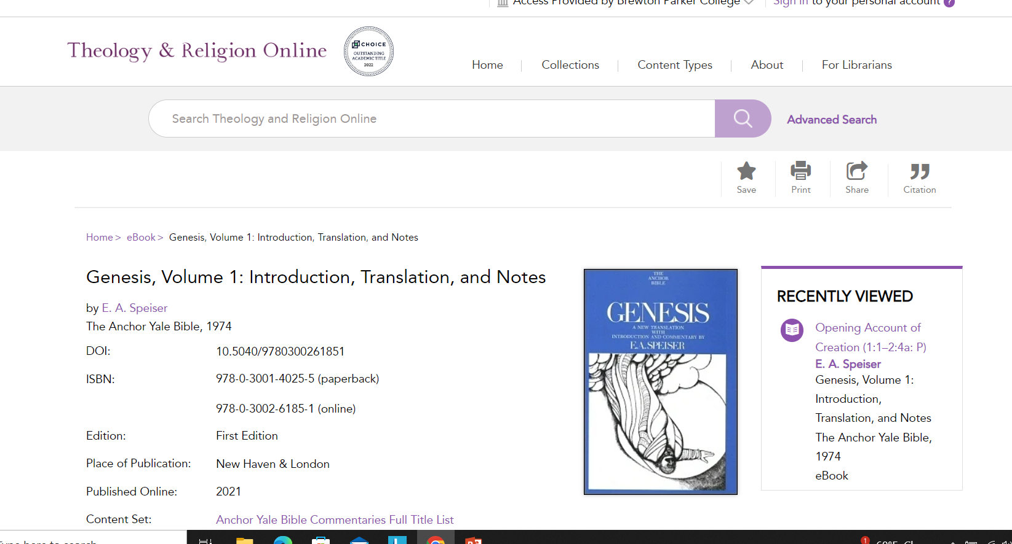
Anchor Yale Bible Commentaries

Slide 6
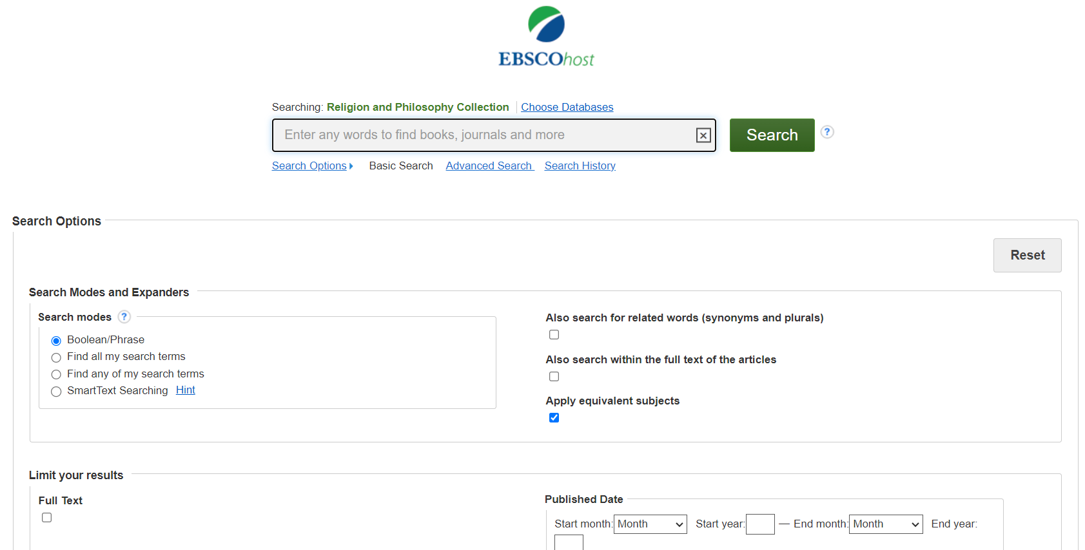
EBSCO Religion and Philosophy Collection

Slide 7
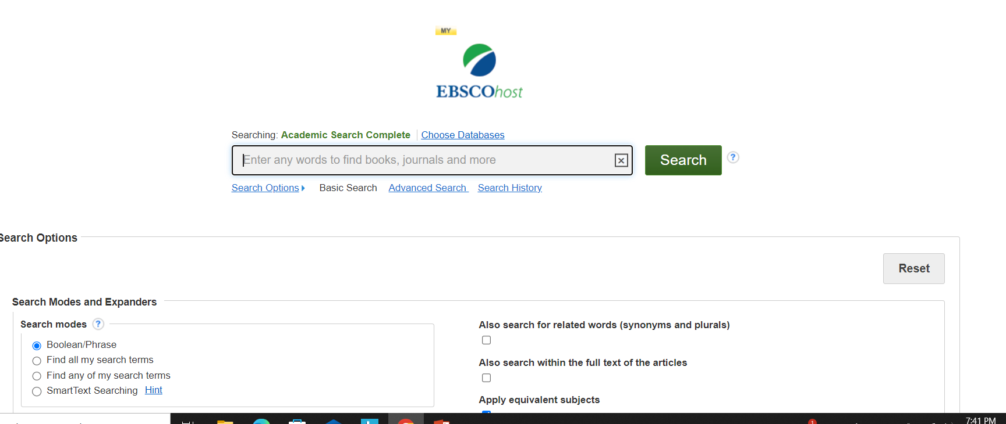
Academic Search Complete

Slide 8
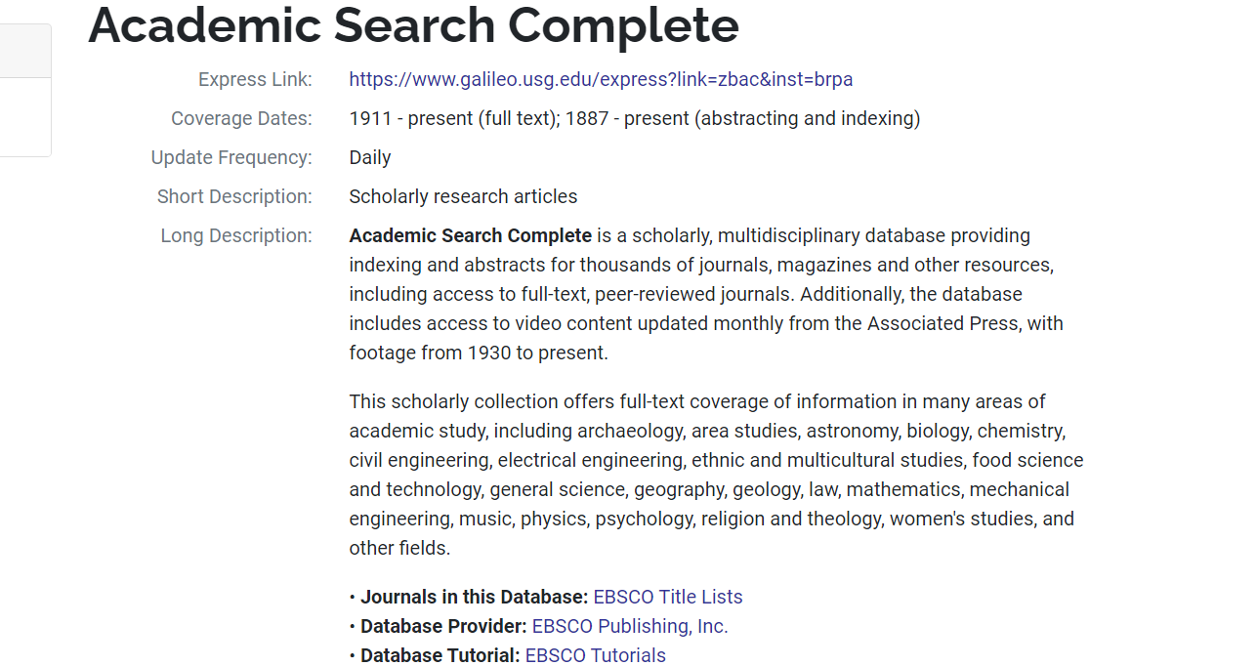
Information About Academic Search Complete

Slide 9
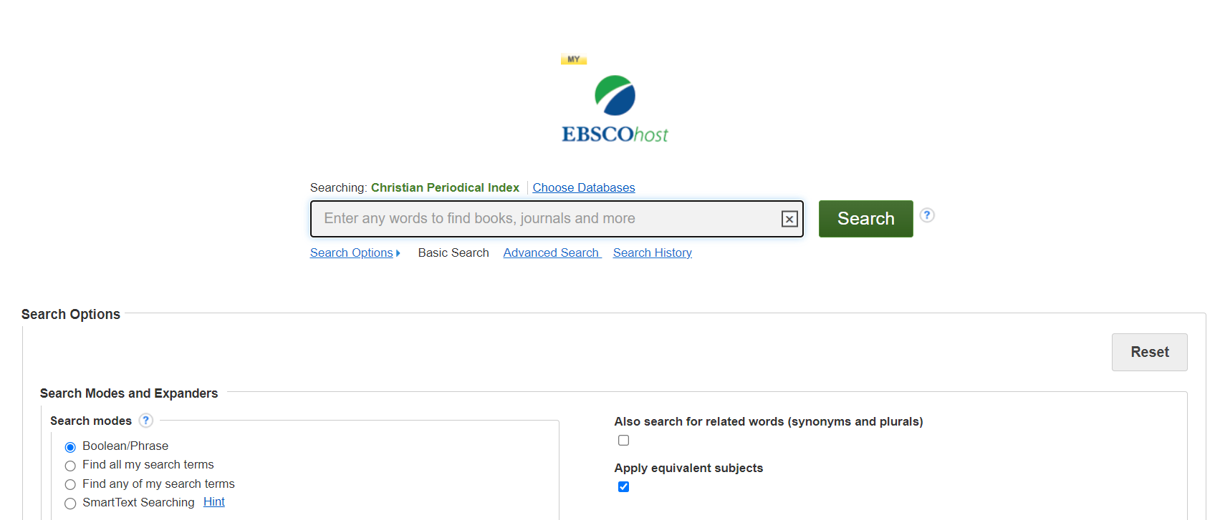
Christian Periodical Index

Slide 10
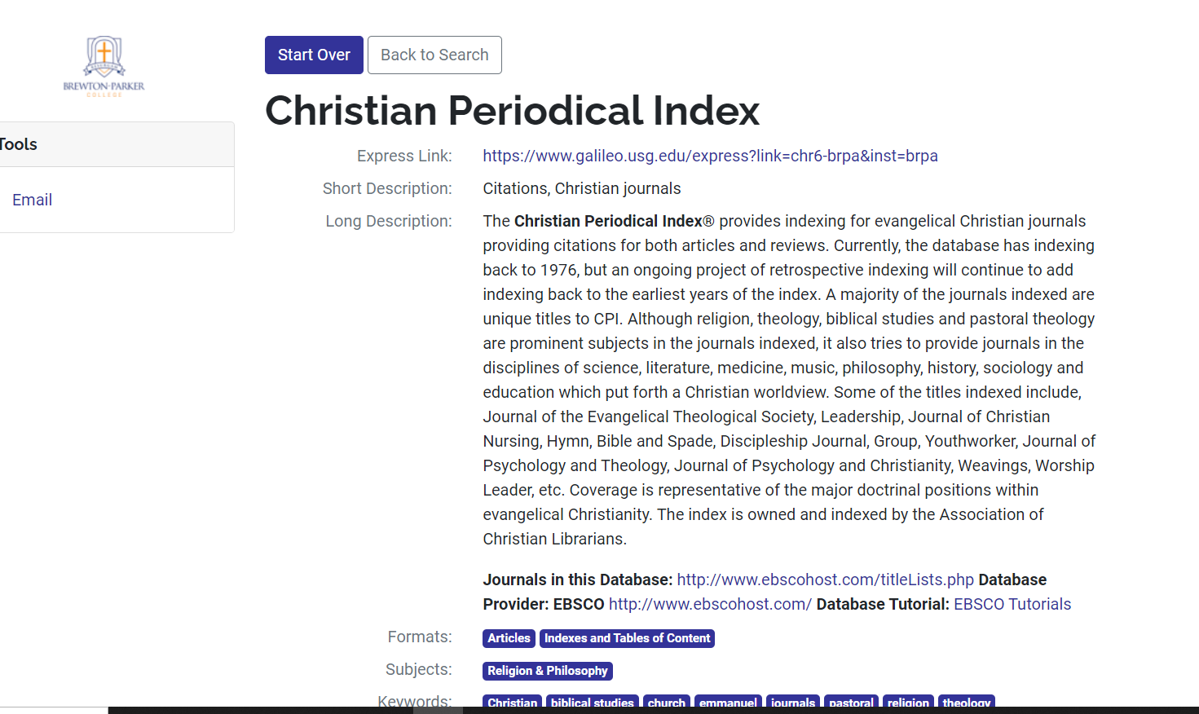
Information About Christian Periodical Index

Slide 11
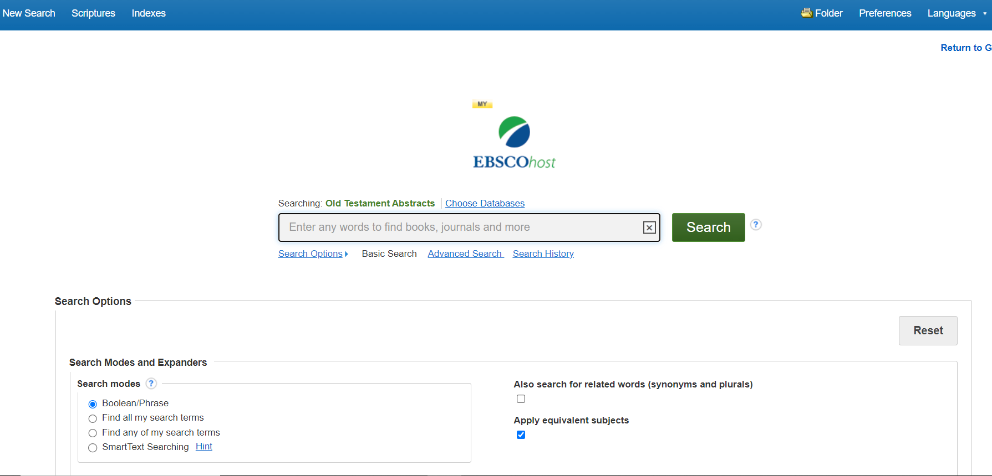
Old Testament Abstracts

Slide 12
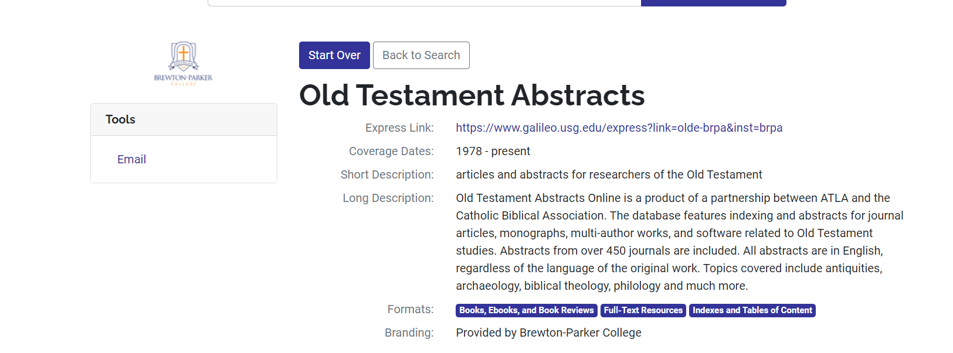
Information About Old Testament Abstracts

Slide 13
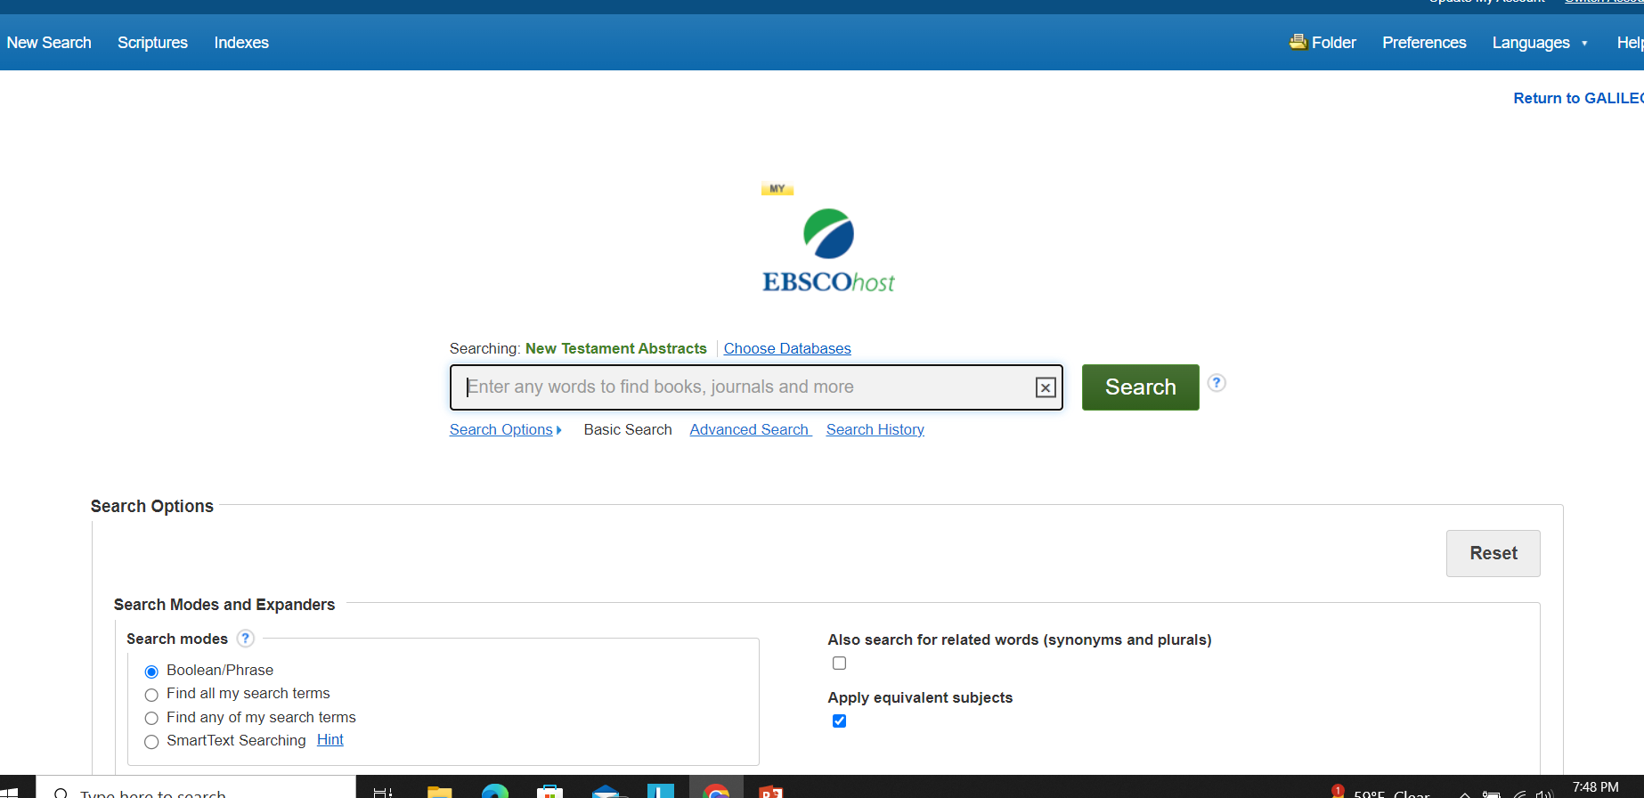
New Testament Abstracts

Slide 14
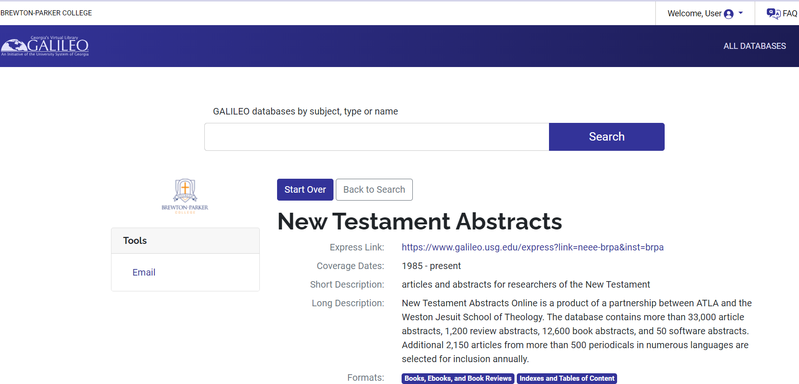
Information About New Testament Abstracts

Slide 15
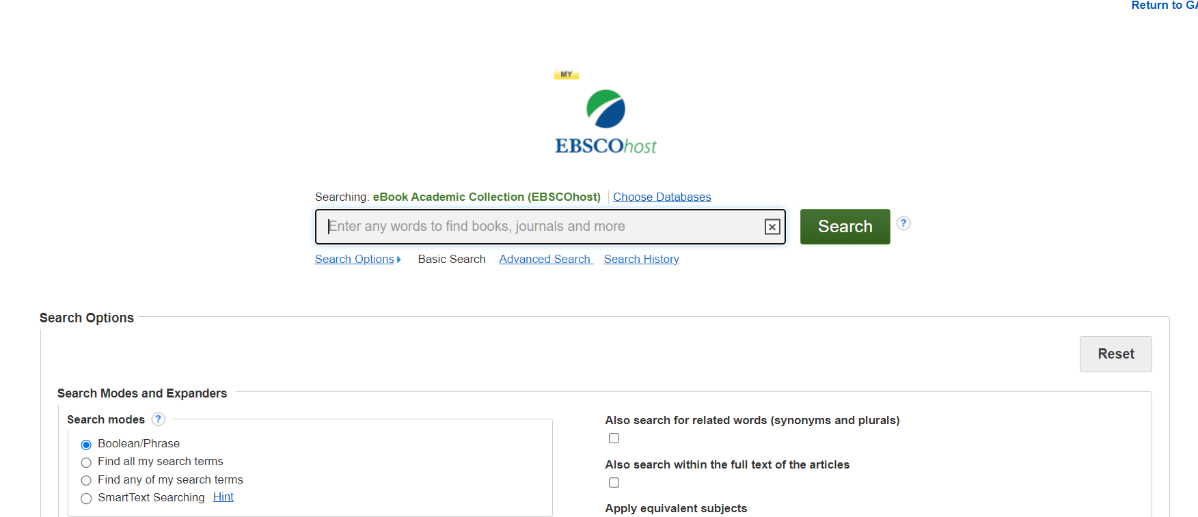
EBSCO E-Books

Slide 16
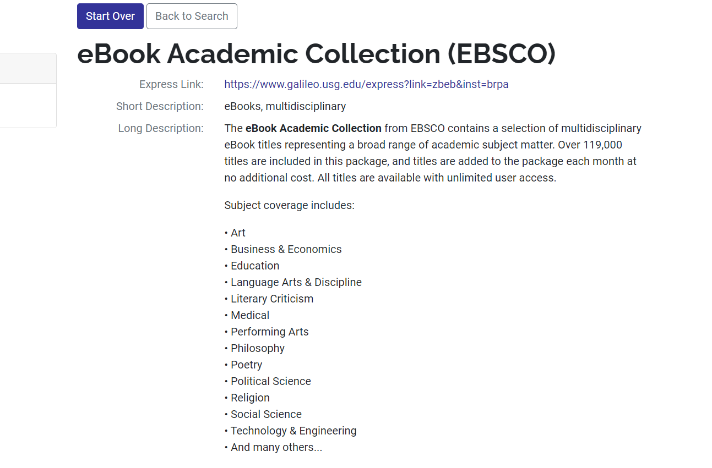
Information About the Ebsco E-Books

Slide 17
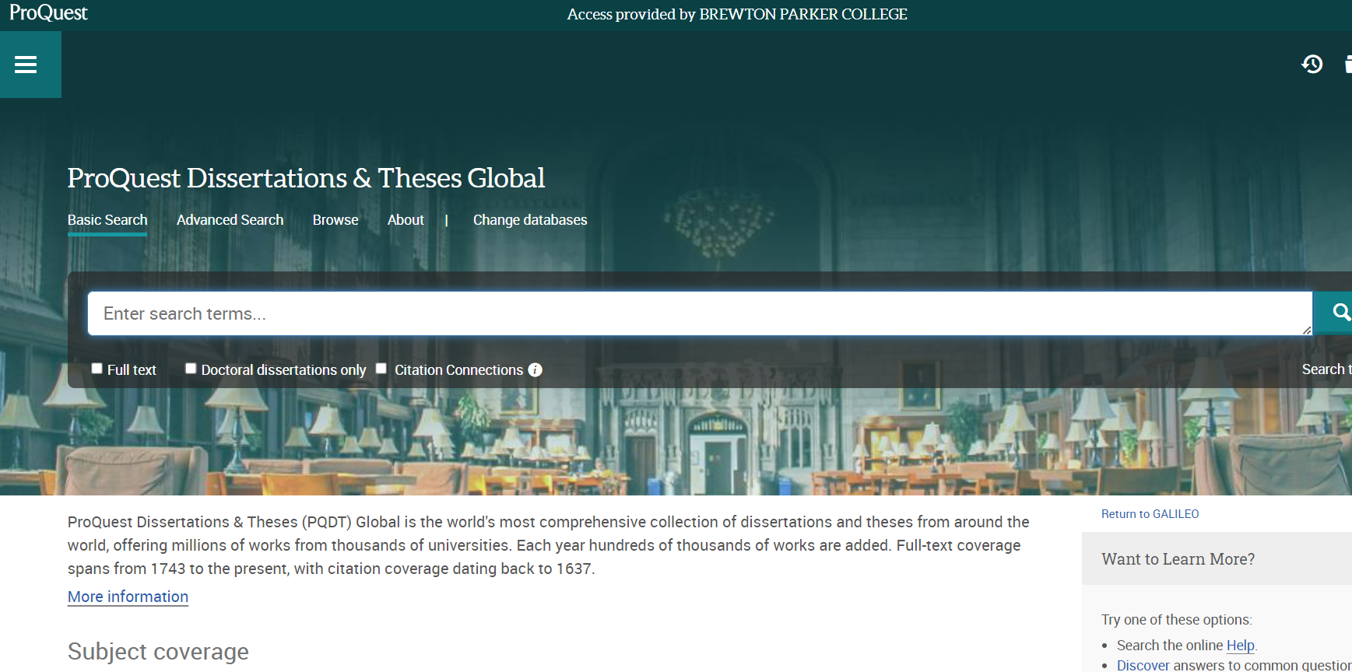
Proquest Dissertations

Slide 18
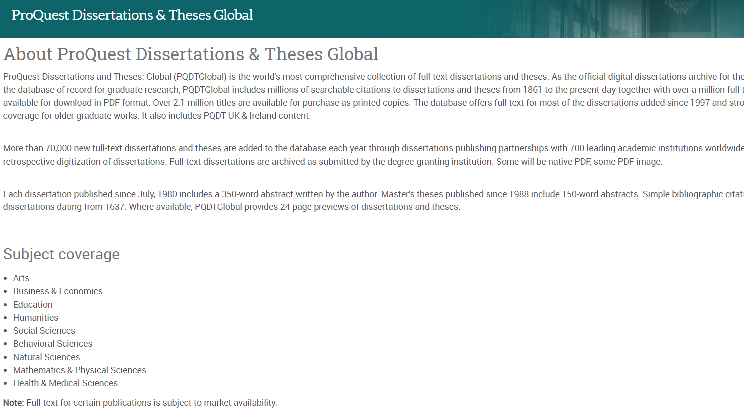
Information About Proquest Dissertations

