Slide 1
Introduction to Graduate Research
Part 1

Slide 2
Accessing Library Resources
Go to Brewton-Parker College’s Website: https://www.bpc.edu
Click on the down menu for Academics & Degrees: Click on Library:
https://www.bpc.edu/academics-degrees/related-offices/library/
On the bottom in the middle is Galileo with a search box. This search box gives you access to all of Brewton-Parker College’s Electronic Resources

Slide 3
Databases
Brewton-Parker College has over 200 databases.
Brewton-Parker College has over 20 databases that support the MAM and MABTS degree programs.
Some of these databases are Academic Search Complete, Anchor Yale Bible Commentaries, ATLA Religion Database with ATLA Serials Plus, eBook Academic Collection (EBSCO), Ebook Central (PROQUEST), EBSCO Religion and Philosophy Collection, PROQUEST Religion Database, Old Testament Abstracts, New Testament Abstracts, Christian Periodical Index, and ProQuest Dissertations and Theses Global.

Slide 4
Library Staff
Brewton-Parker College has two full-time librarians to support the MAM and MABTS programs in Biblical and Theological Studies.
Dr. John Shaffett has 27 years of service in various capacities in libraries both public and private, including 14 years as Library Director at The Baptist College of Florida and three more years and six more years at The University of Mobile and Shorter University. Dr. Shaffett holds B. A. and M.A. degrees in Social Studies Education and History, an M. L. I. S. degree in Library Science from Louisiana State University, and a Ph.D. in Humanities from Faulkner University.
Dr. Shaffett can be reached by email: jshaffett@bpc.edu and by phone: 912-583-3230.

Slide 5
Library Staff-Continued
Mr. Christopher Kirk has 10 years of experience in various capacities in libraries both public and private. Mr. Kirk holds bachelor’s and master’s degrees in English literature and the Humanities, as well as an M. S. I. S. degree from the University of North Texas School of Library and Information Science.
Mr. Kirk can be reached by email: ckirk@bpc.edu and by phone: 912-583-3232

Slide 6
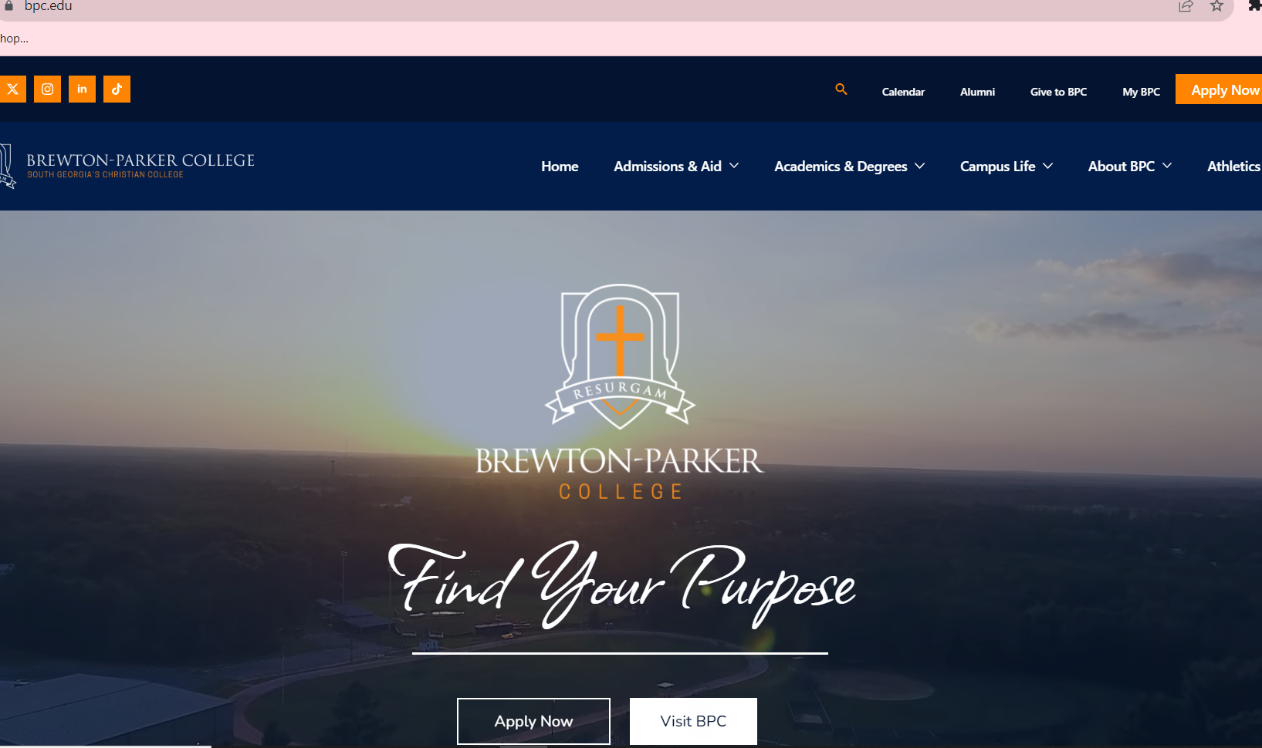
Brewton-Parker College Website

Slide 7
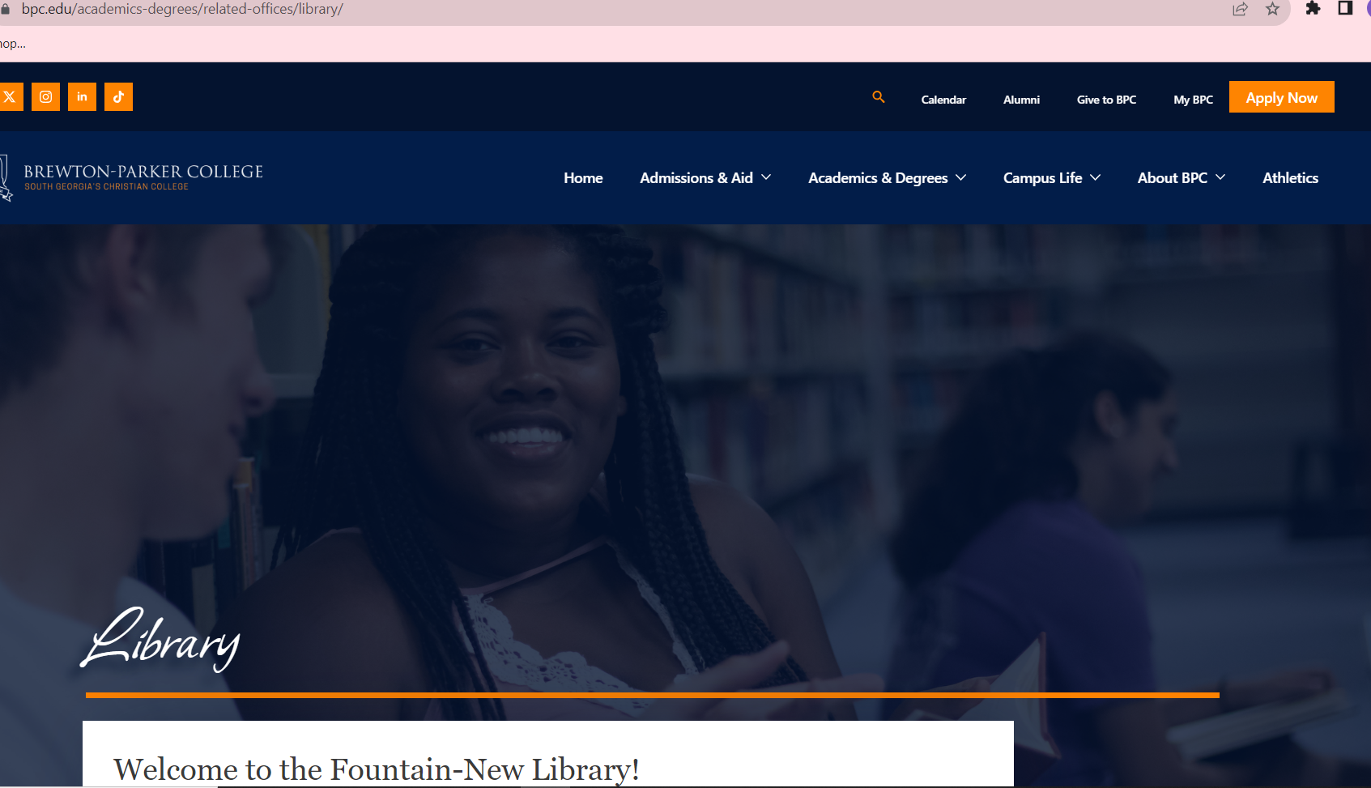
Library Webpage

Slide 8

Access to Electronic Resources

Slide 9
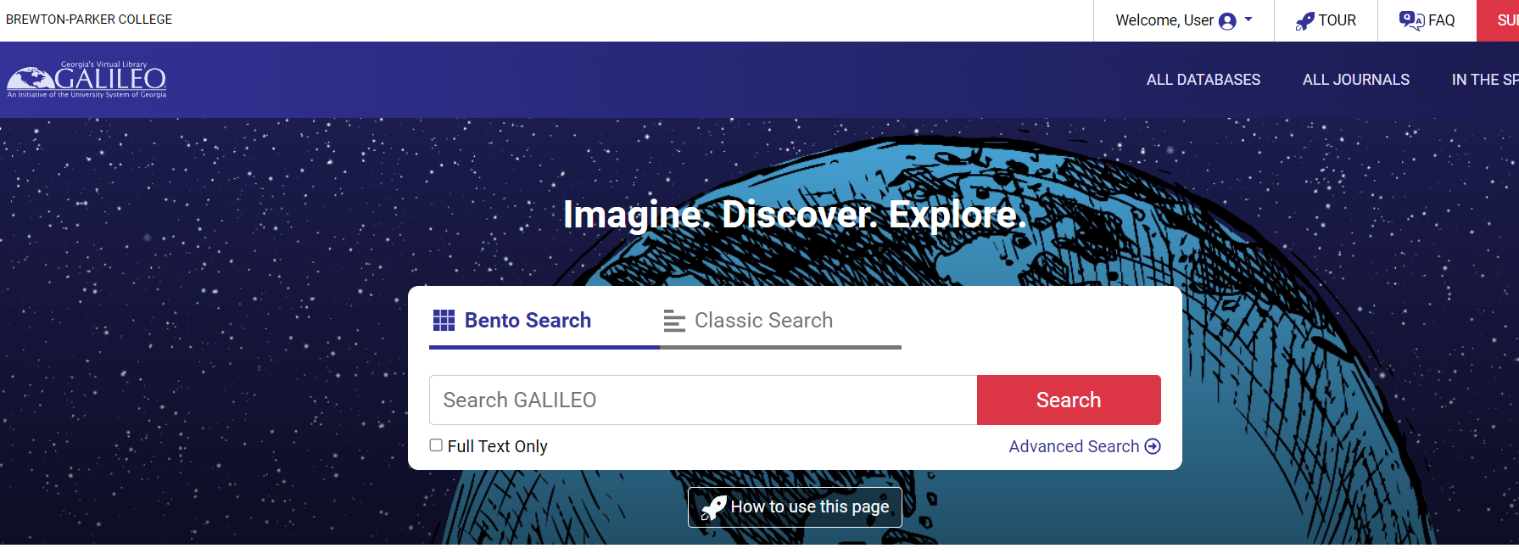
Galileo

Slide 10
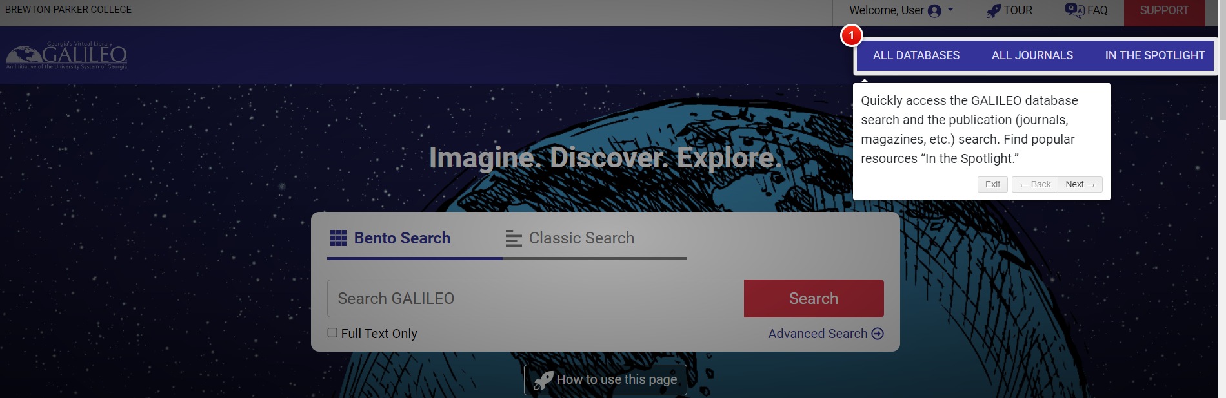
How to Use the Galileo Page

Slide 11
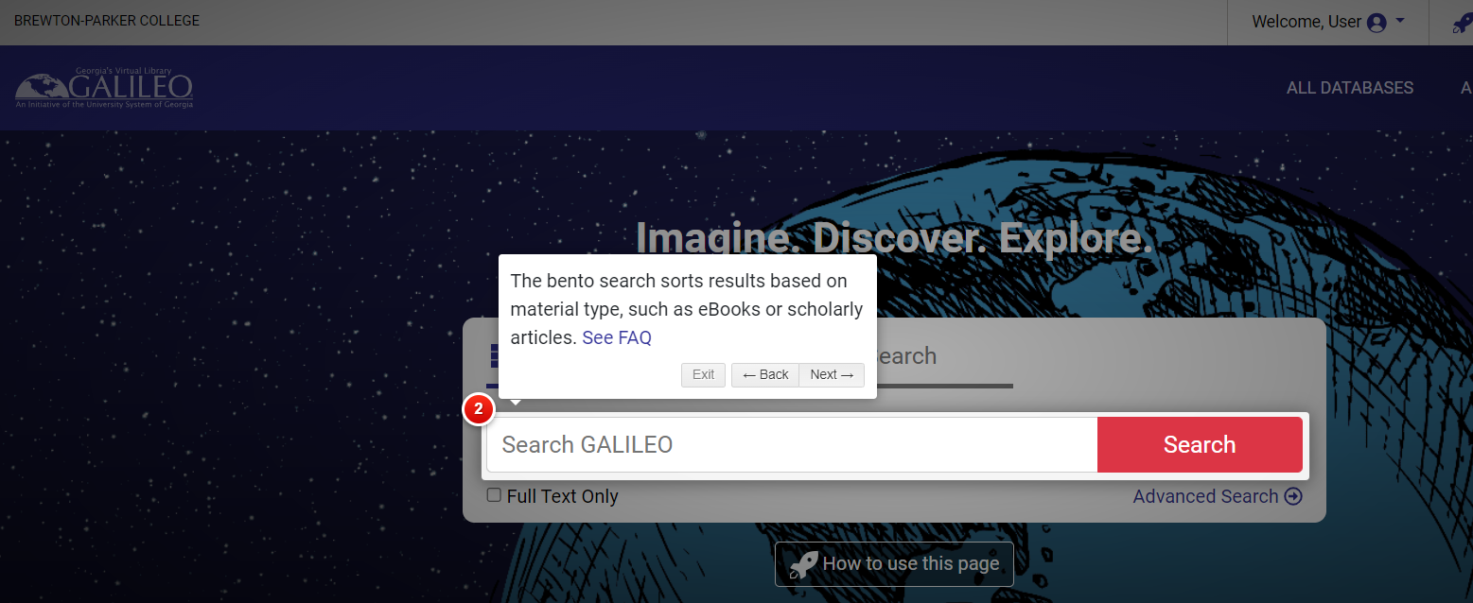
How to Use Galileo-Page 2

Slide 12
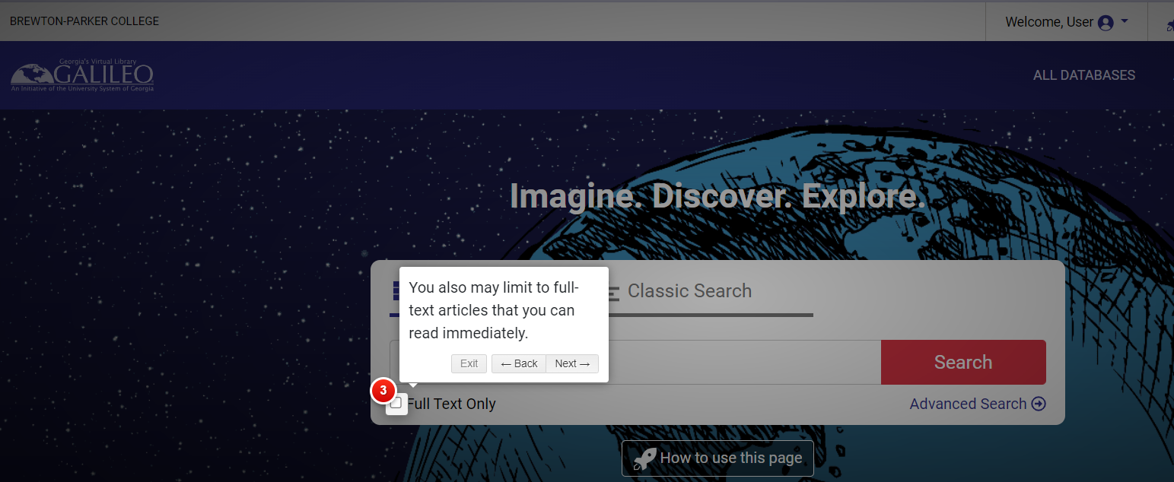
How to Use Galileo Page 3

Slide 13
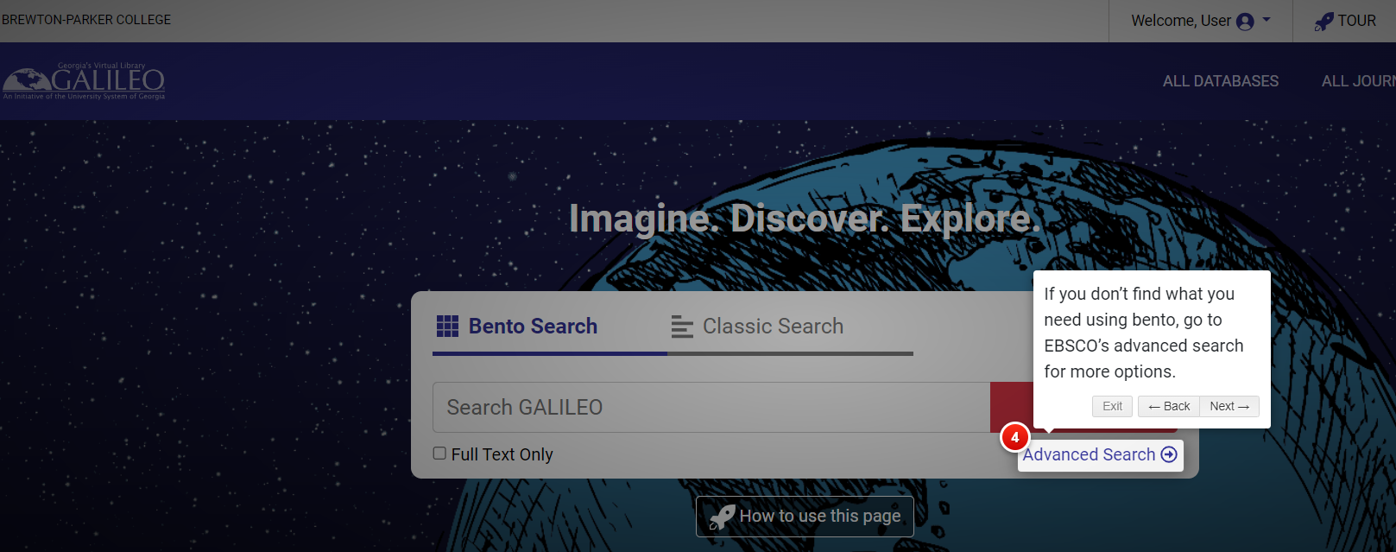
How to Use Galileo- Page 4

Slide 14
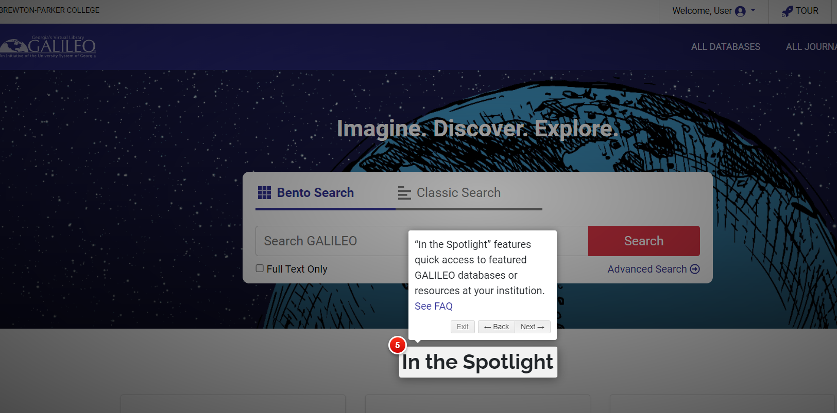
Intro to Galileo-Page 5

Slide 15
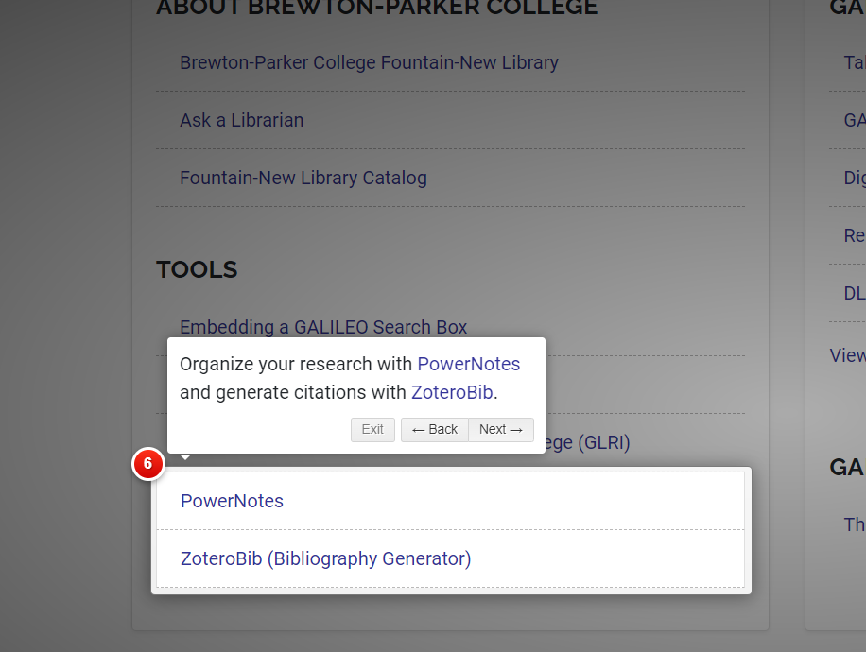
Intro to Galileo- Page 6

Slide 16
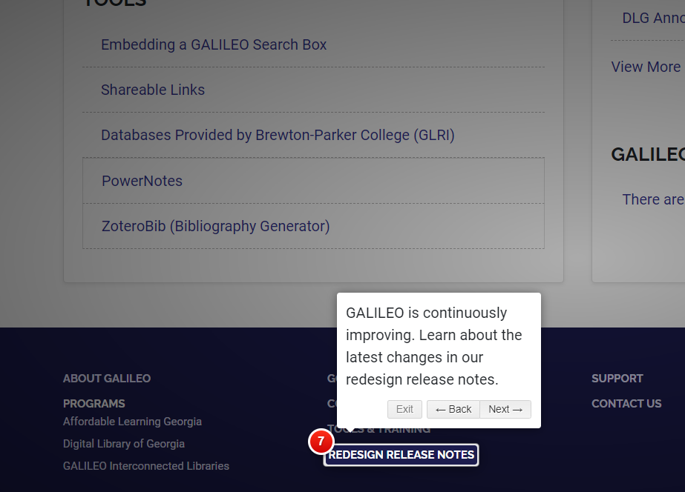
Intro to Galileo Page- 7

Slide 17
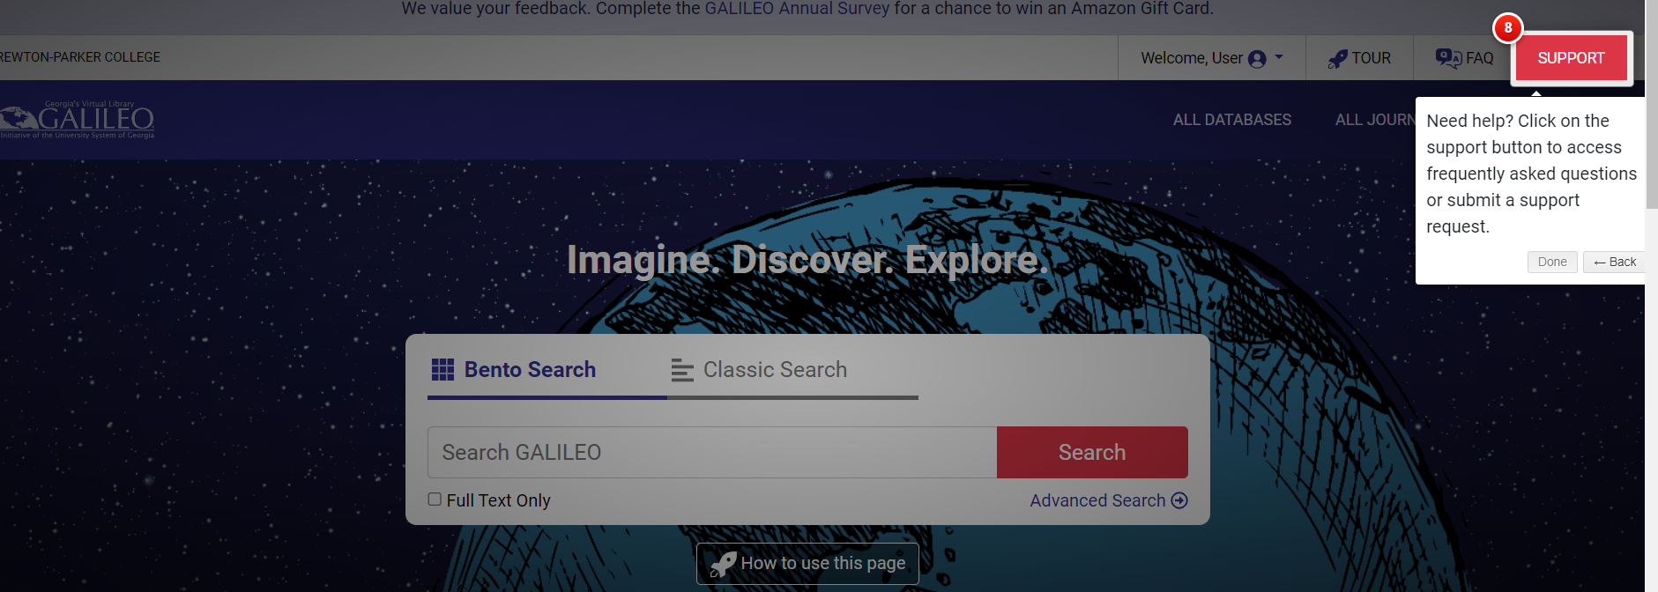
Intro to Galileo Page 8

Slide 18
Introduction to Graduate Research
This is the first part of the Introduction to Graduate Research Course

