Slide 1
Intro to Graduate Research
Searching for Journal Articles: Ebsco Discovery Service

Slide 2
Searching for Journal Articles
There are two basic methods for searching for journal articles in Brewton-Parker Databases: searching the school’s Ebsco Discovery Service or searching an individual database. This tutorial will show you how to search with the Ebsco Discovery Service. The next tutorial will show you how to search with an individual database.

Slide 3
Ebsco Discovery Service
Ebsco Discovery Service (EDS) provides you with access to your institution’s entire collection of electronic resources via a single entry point. In this tutorial, we will look at performing a search by using the Ebsco Discovery Service.

Slide 4
Accessing the Ebsco Discovery Service
Go to the school’s website: https://www.bpc.edu
Click on the down menu for Academics & Degrees: Click on Library:
https://www.bpc.edu/academics-degrees/related-offices/library/
On the bottom of the page, click the box under Galileo

Slide 5
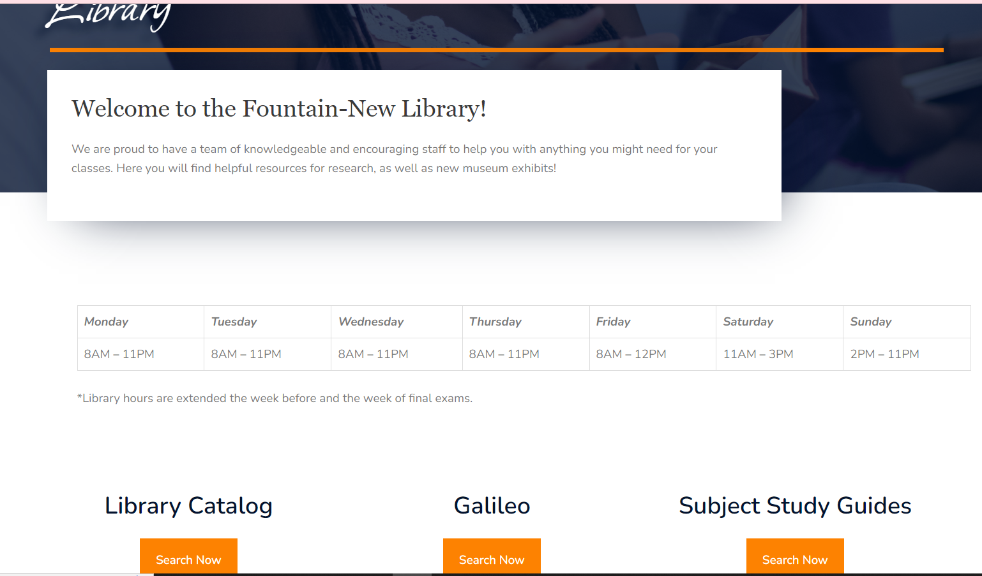
Library WebPage

Slide 6
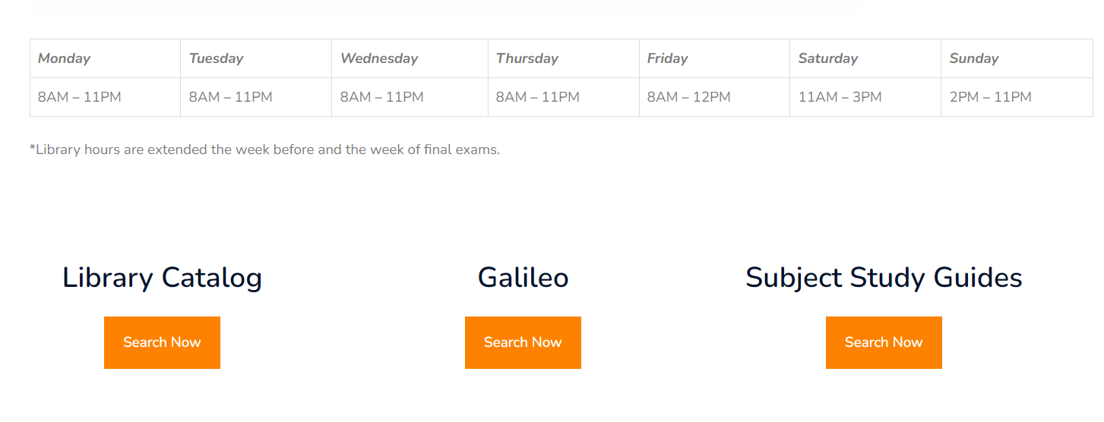
Click on the box under Galileo

Slide 7
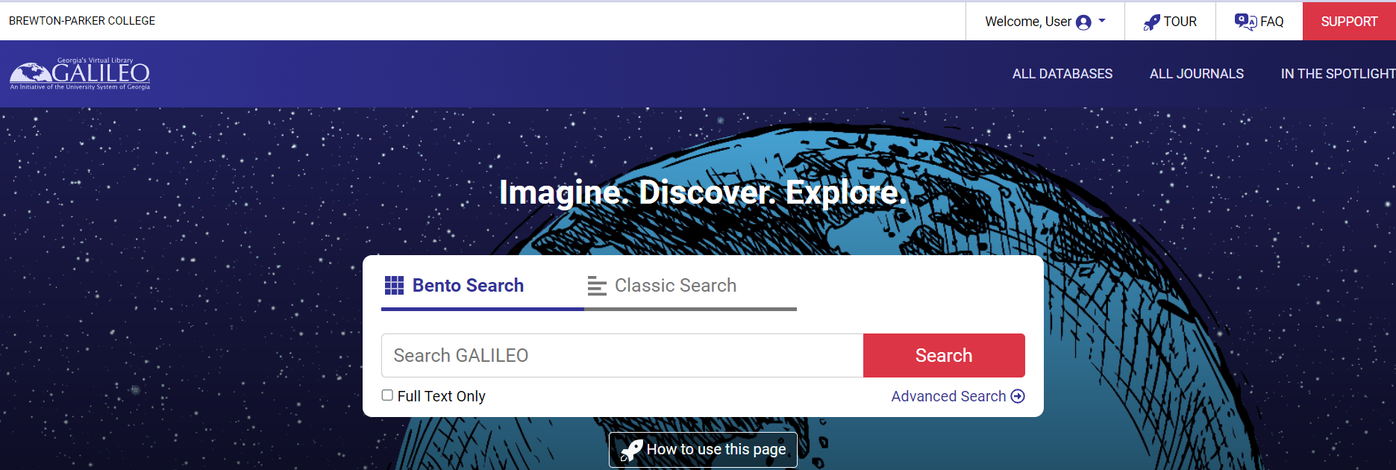
Clicking the Box Brings You to the Galileo Page

Slide 8
Keyword Search in Ebsco Discovery
When you put search terms in the Galileo box, it will do a search in Ebsco Discovery and provide results
We will do a search as an example

Slide 9
Doing a Keyword Search
Keyword searching allows you to search for single words or phrases, as well as for combinations of words and phrases, in just about every field

Slide 10
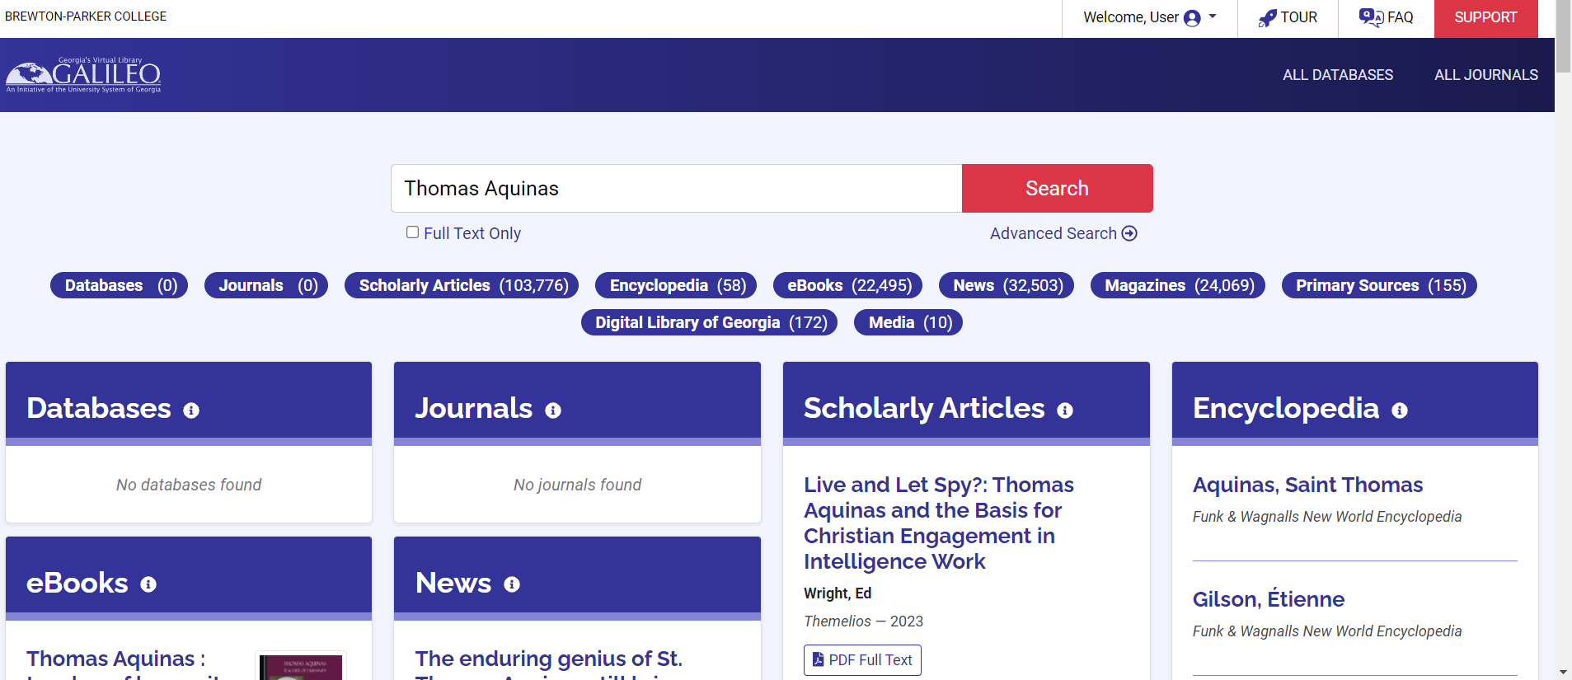
Search Results

Slide 11
Different Types of Sources As A Result of the Search
Scholarly Articles
E-Books
Magazines
News
Primary Sources
Others

Slide 12
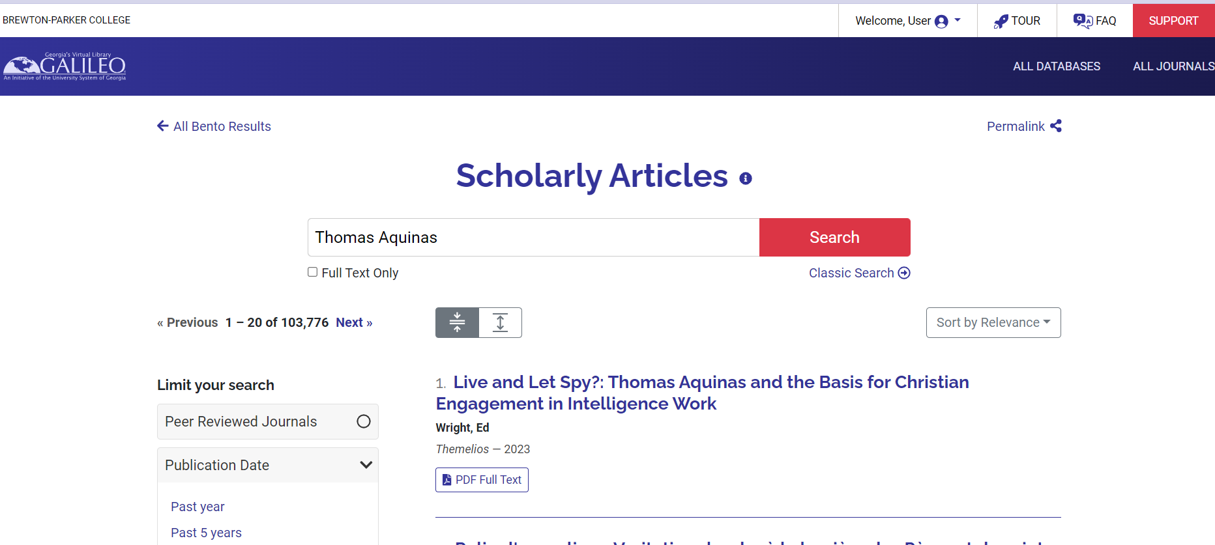
Searching the Scholarly Articles

Slide 13
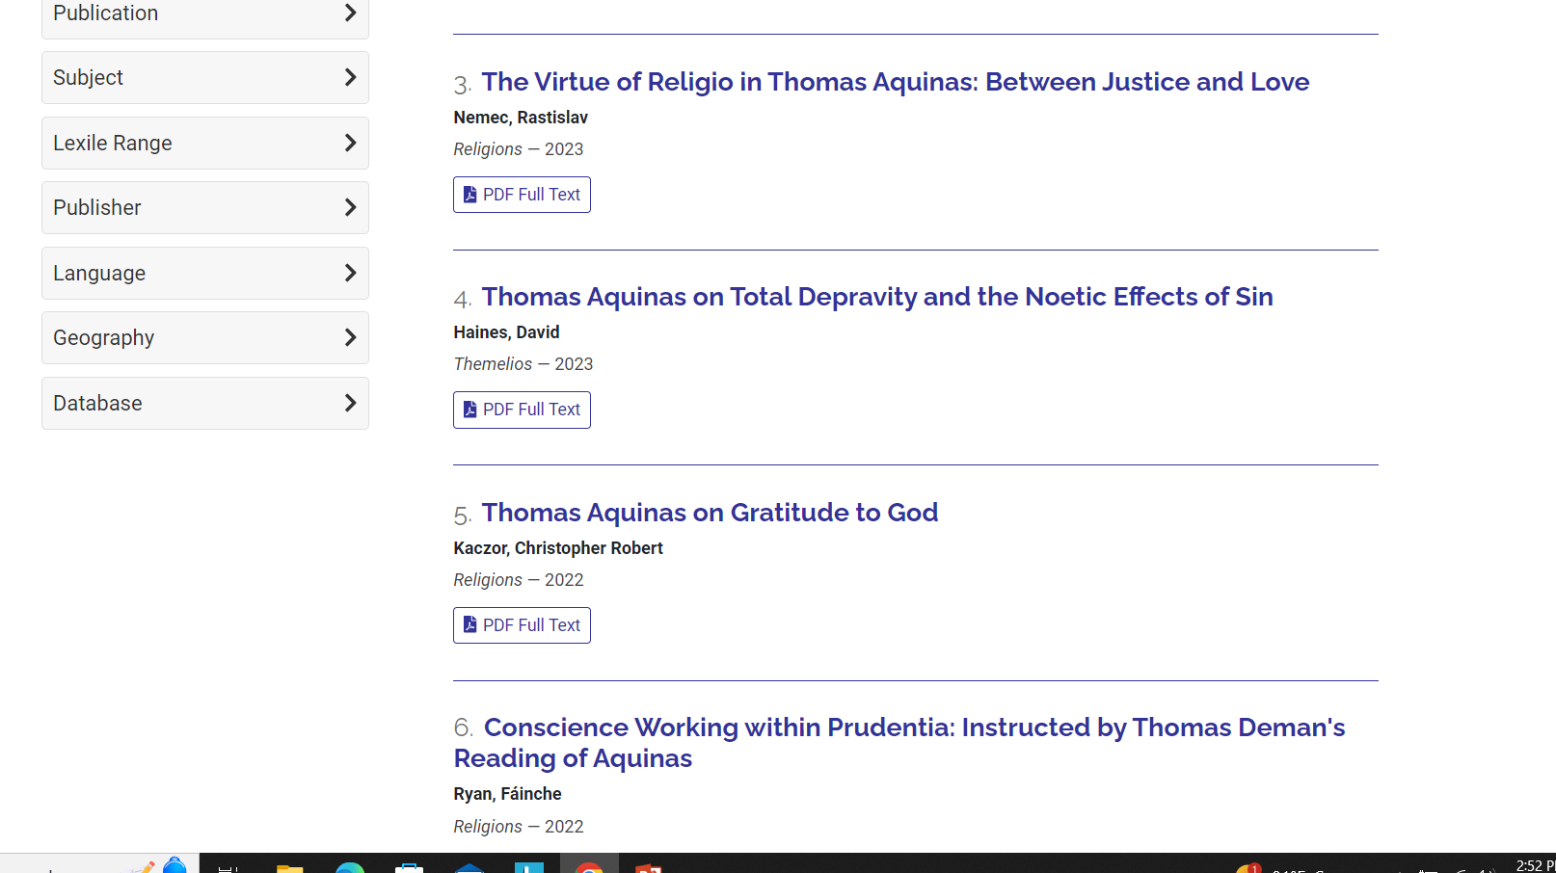
More Results

Slide 14
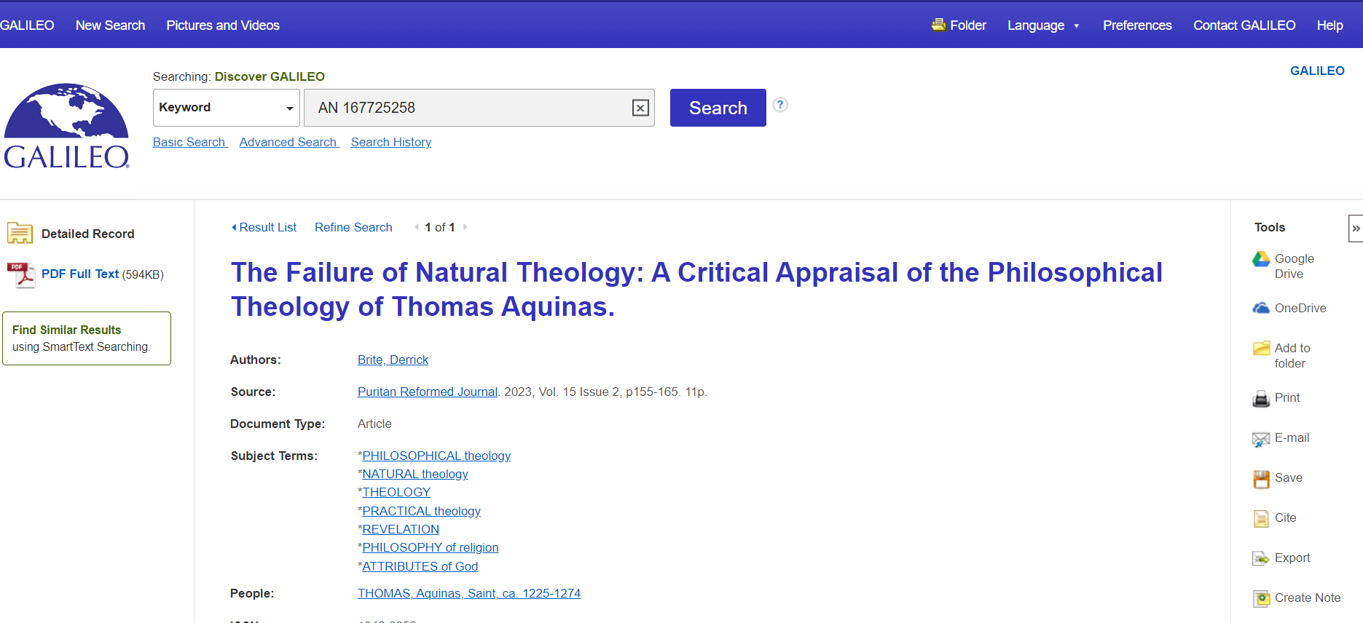
Retrieving the article

Slide 15
Different Options
You can view the full text of the article
You can save the article
You can print the article
You can refine your search from the results list

Slide 16
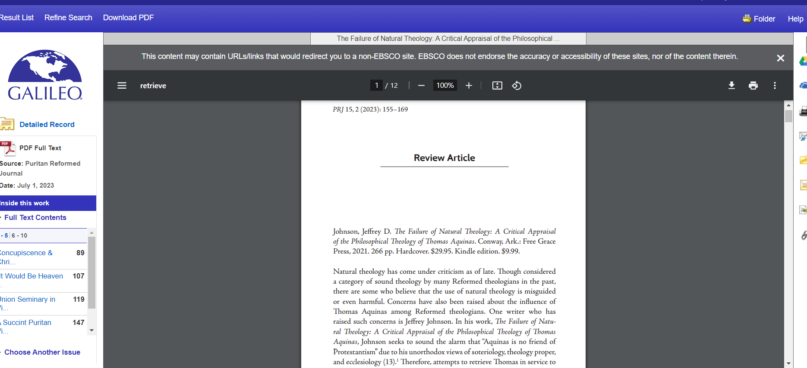
View the Full-text

Slide 17

Other Options

Slide 18
You can Refine Your Search From the Results Page
You can apply limiters under Limit To or use the available facets (such as Sour Type, Subject, and Geography) all found in the left column. Click the Show More link when displayed to view all options.

Slide 19
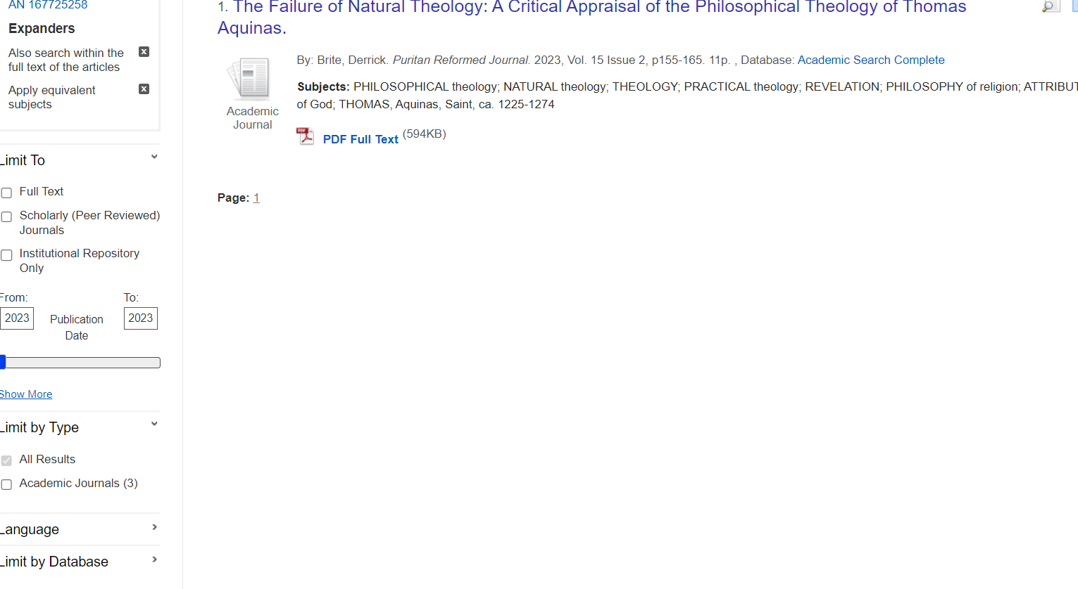
Using the Filters to be more specific

Slide 20
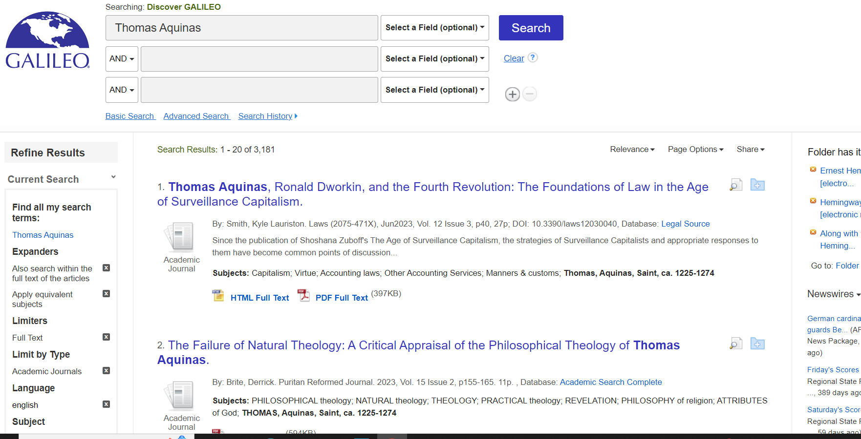
You Can Go to the Advance Search for Even More options

Slide 21
Next Tutorial
In the next tutorial, you will learn how to search an individual database

