Slide 1
Intro to Graduate Research
Searching an Individual Database for Journal Articles

Slide 2
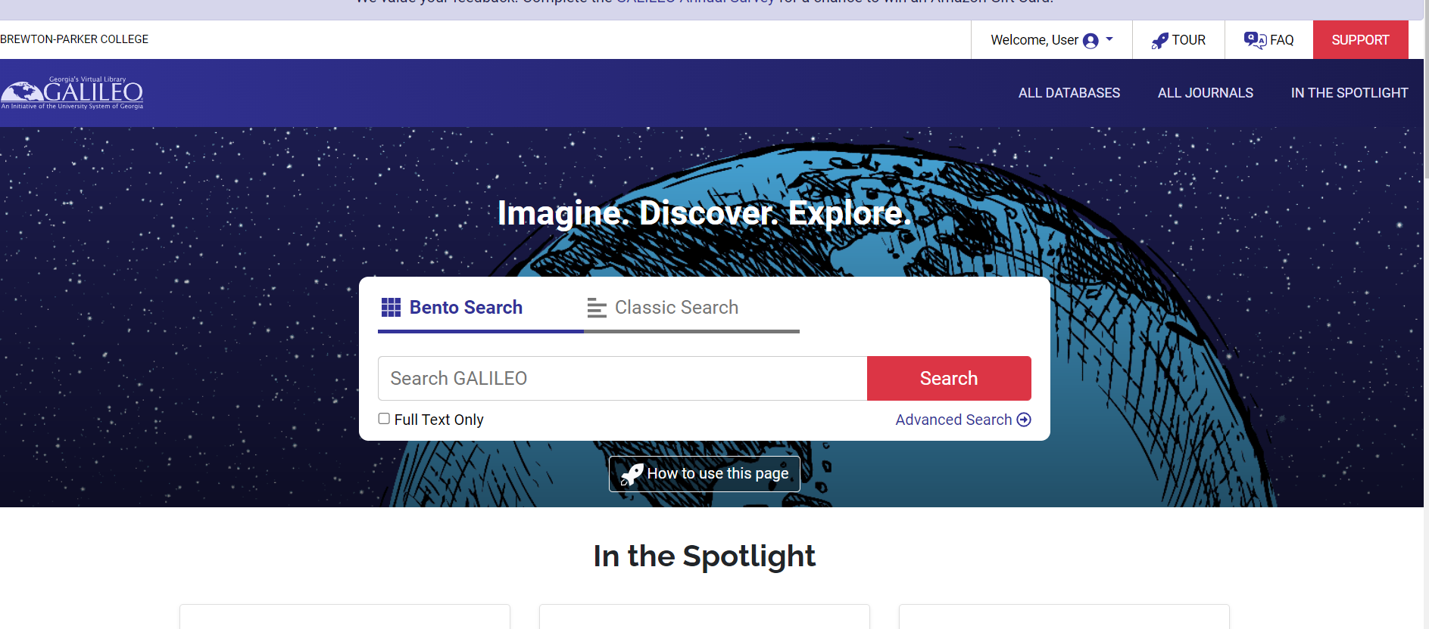
Galileo Page

Slide 3
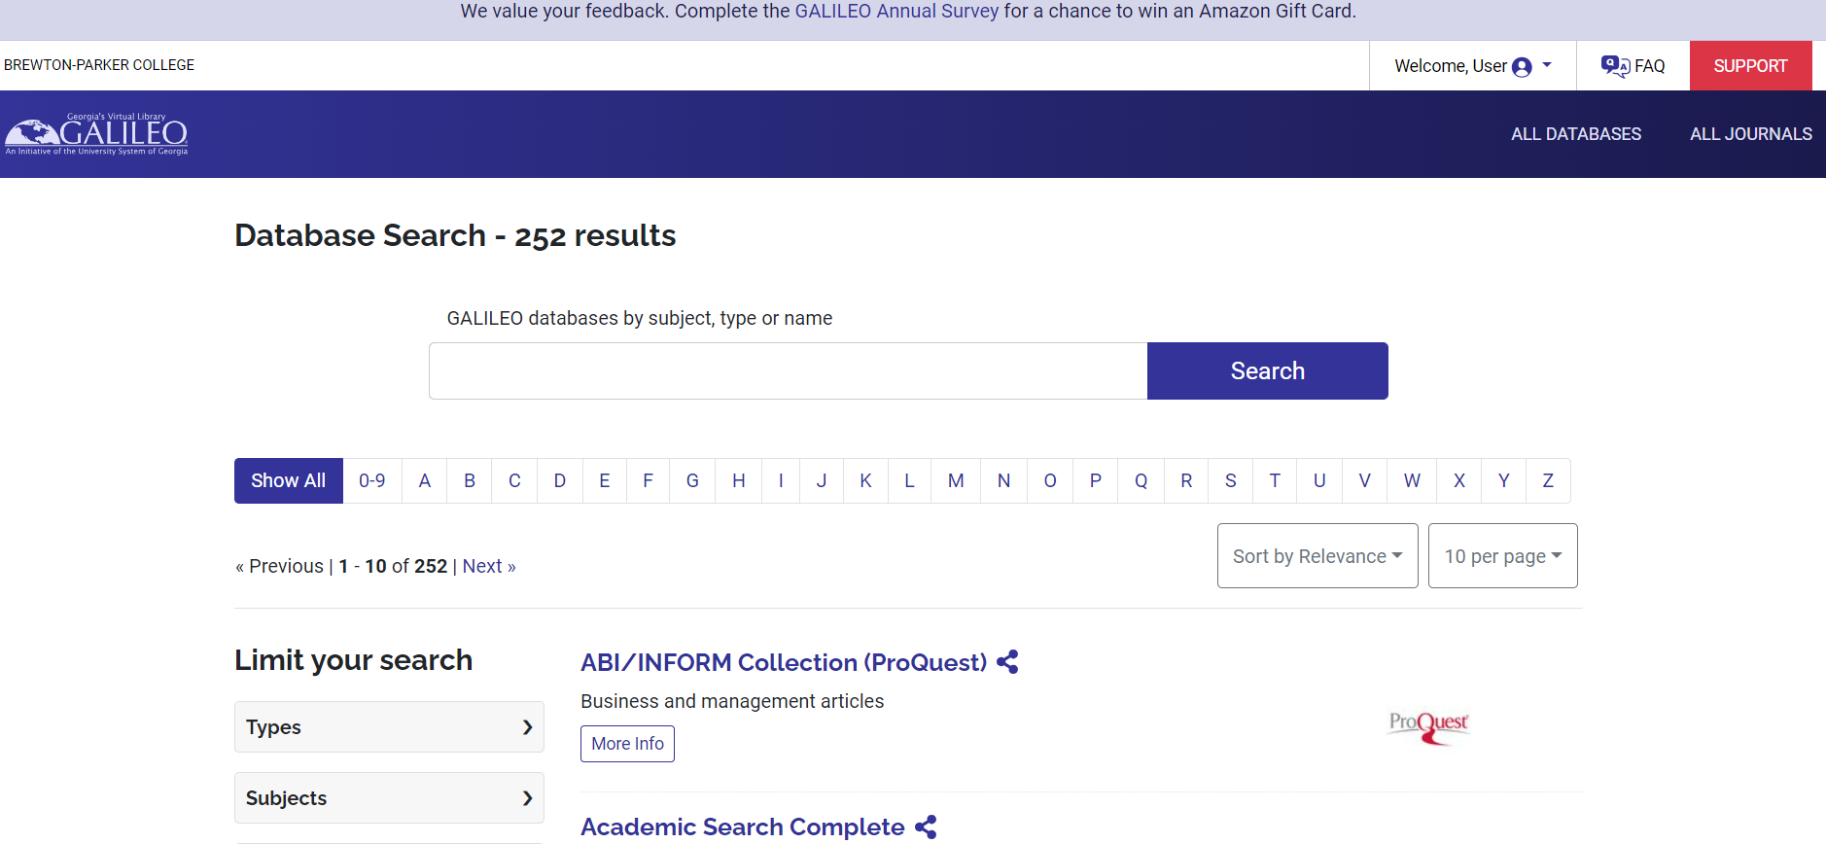
Click on All Databases at the Top on the Right

Slide 4
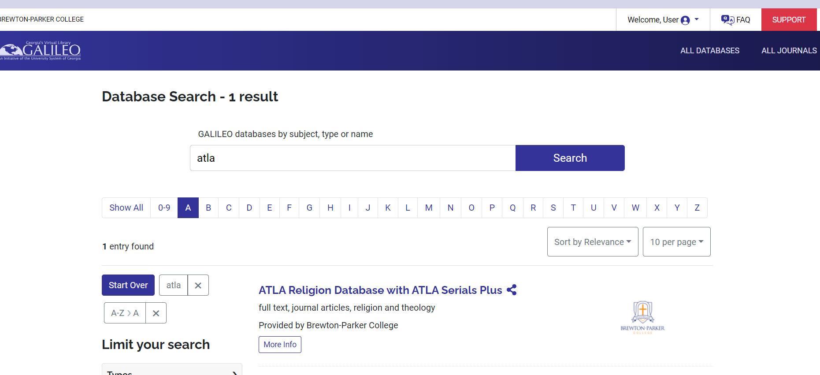
Click on the “A” or Just type ATLA in the Box

Slide 5
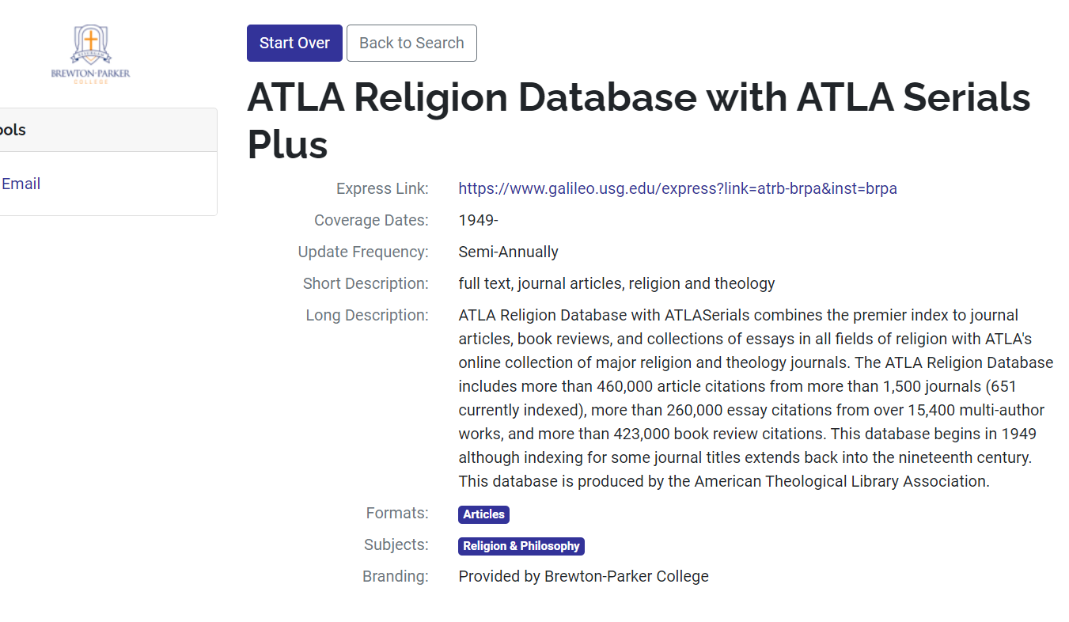
Information About ATLA Religion Database with ATLA Serials Plus

Slide 6
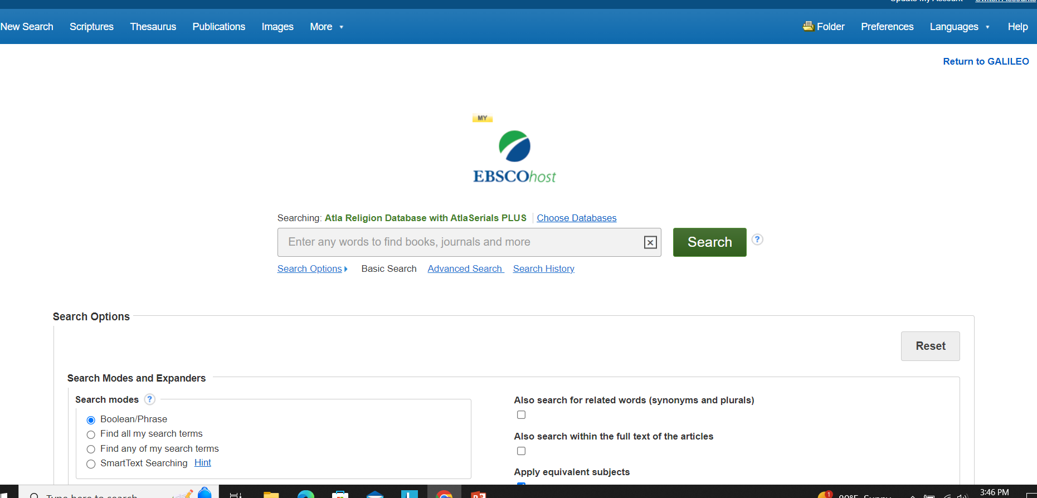
Click on ATLA Religion Database. You are now searching only one database.

Slide 7
How to do a Scripture Citation Search in ATLA Religion Database
Click into the ATLA Religion Database
At the top of the screen, mouse over More.
A link to indexes should appear when you mouse over the word More. Click on Indexes.
Use the button to the right of Select to select the Scripture Citation Field.

Slide 8
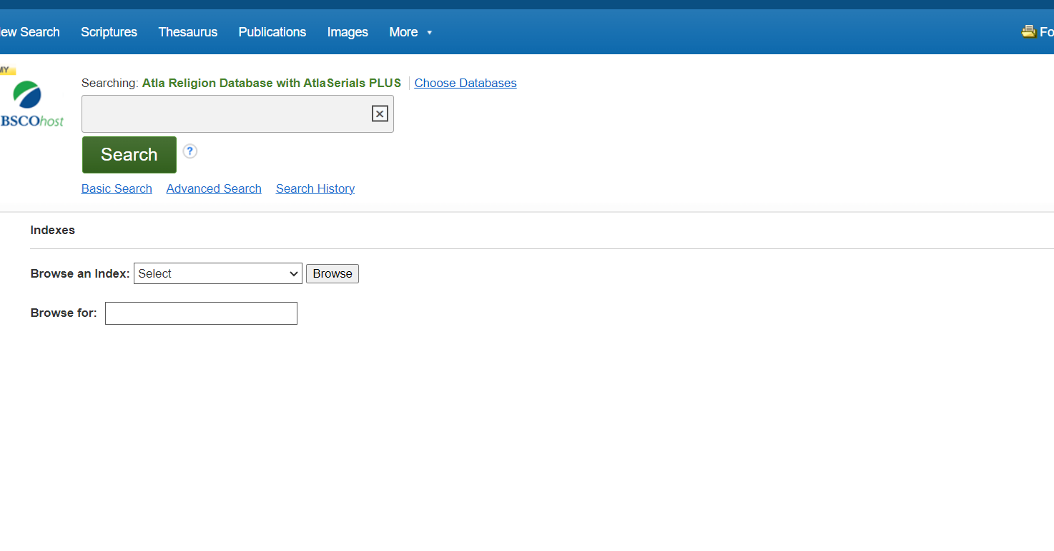
Scripture Citation Search

Slide 9
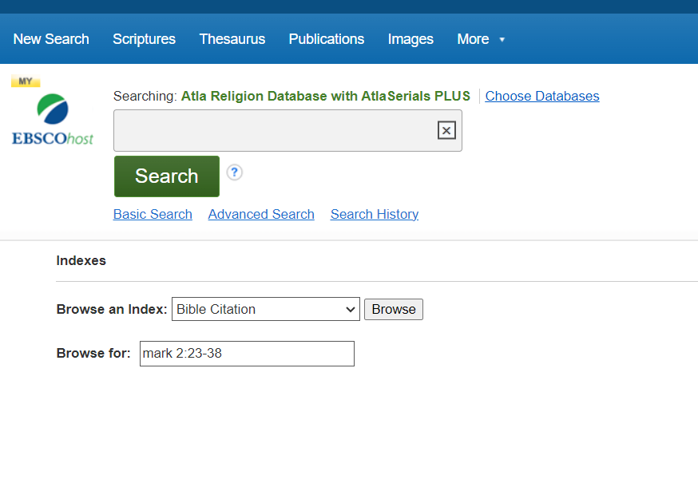
Scripture Citation Continued

Slide 10
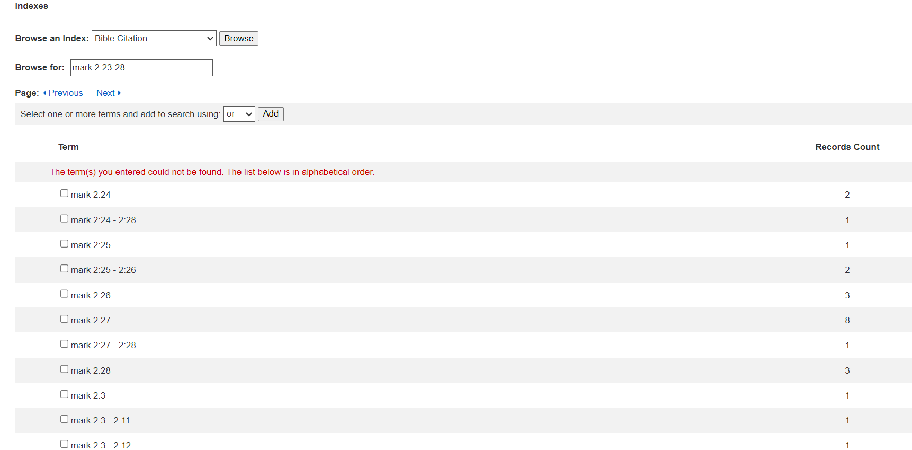
Bible Citation Results

Slide 11
Screenshot
The following screen shows a number of references or articles which deal with either all or a portion of your biblical references. Click on the entries which apply to your book, chapter and verse.

Slide 12
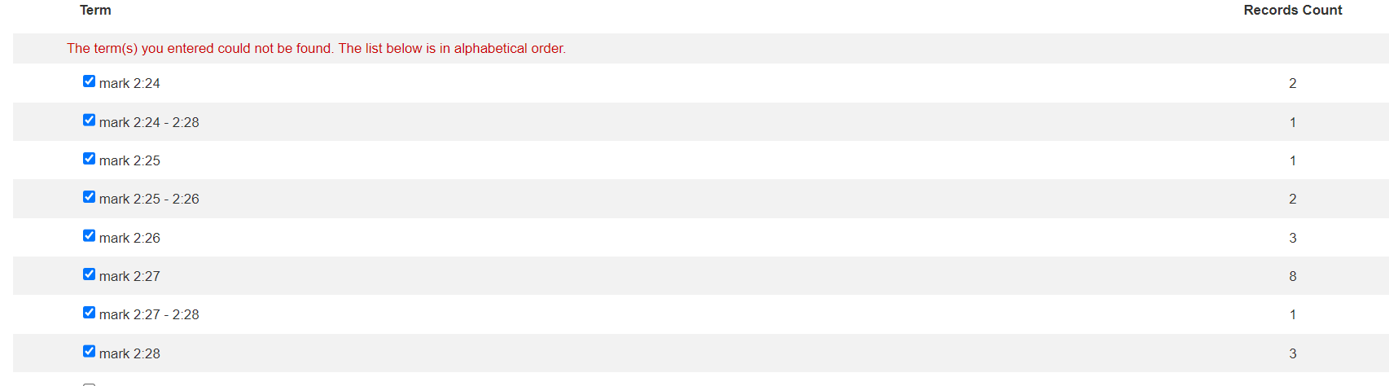
Selecting the Results

Slide 13
Combining the Results
Click on the ADD button to add these references to the search box and click Search.
References to articles that pertain to your scripture references should appear.

Slide 14
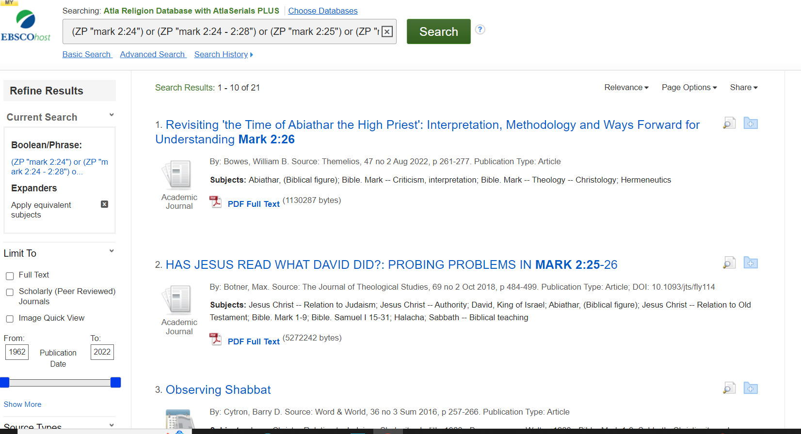
Search Results

Slide 15
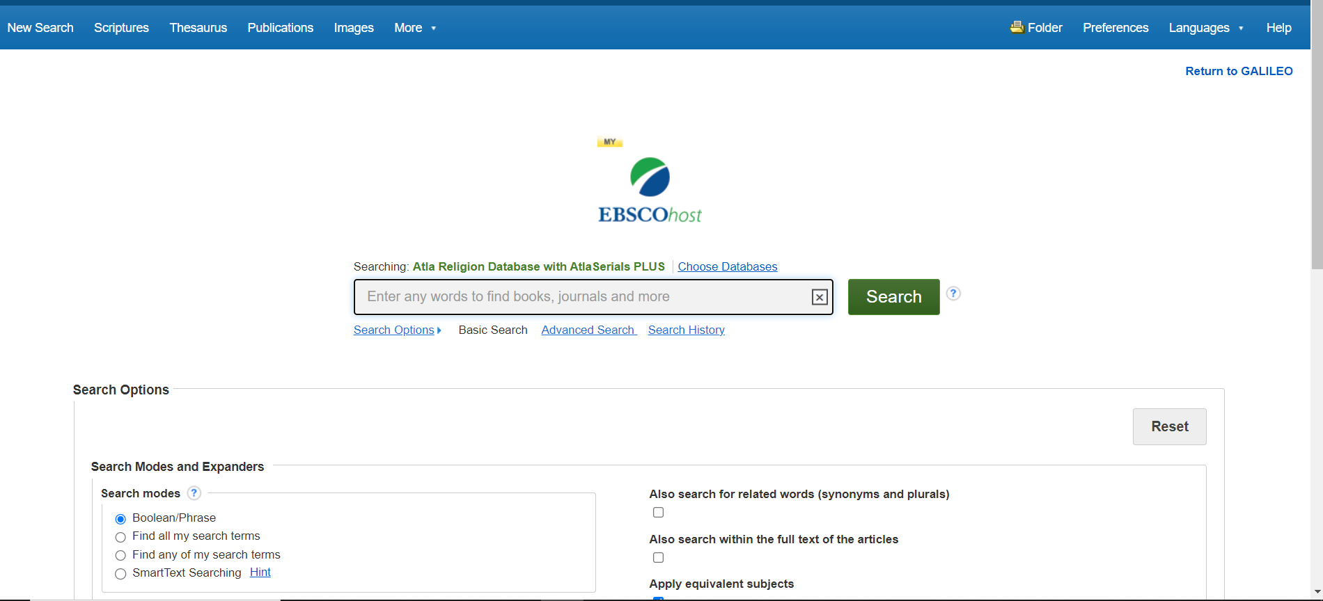
Creating a Search in ATLA Using the Regular Search Box: Just Click on new search at top

Slide 16
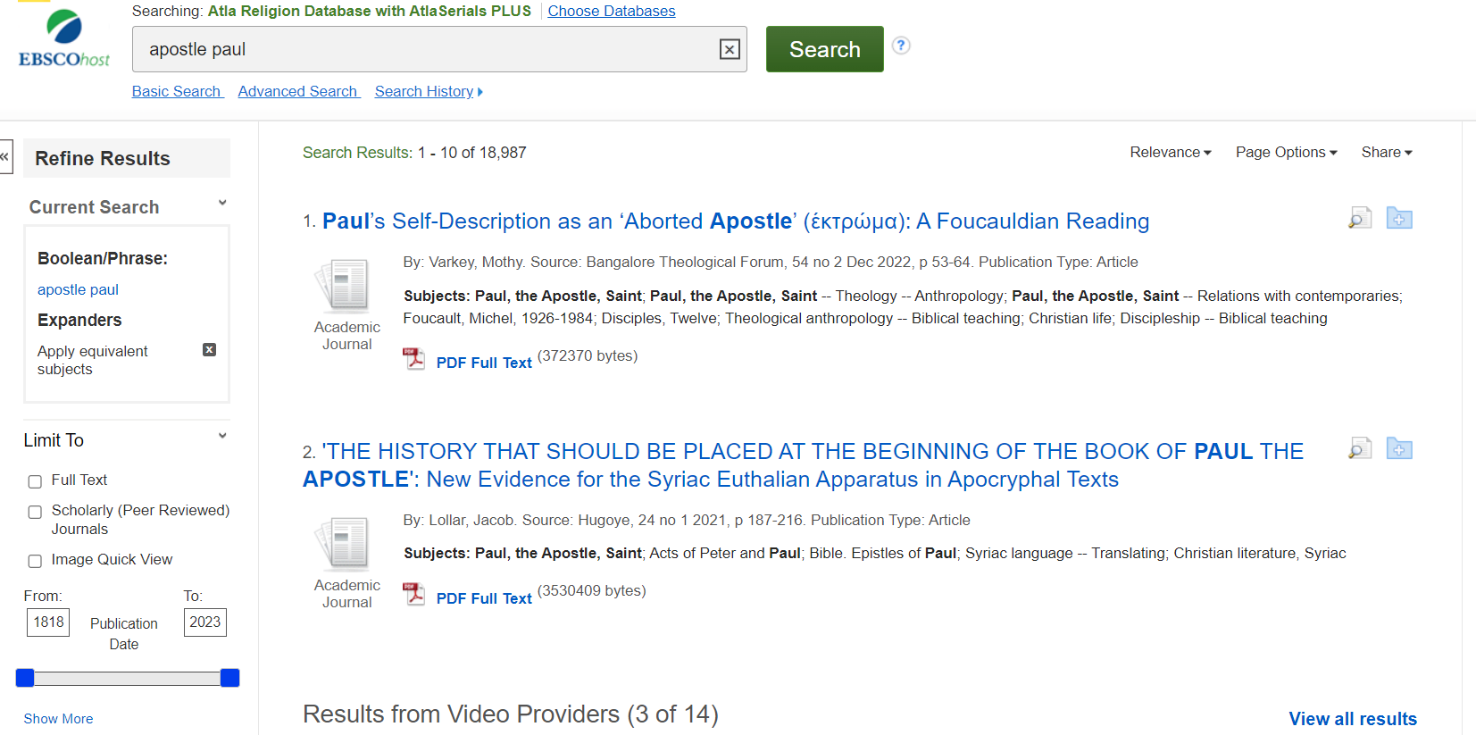
Do a Search on the Apostle Paul

Slide 17
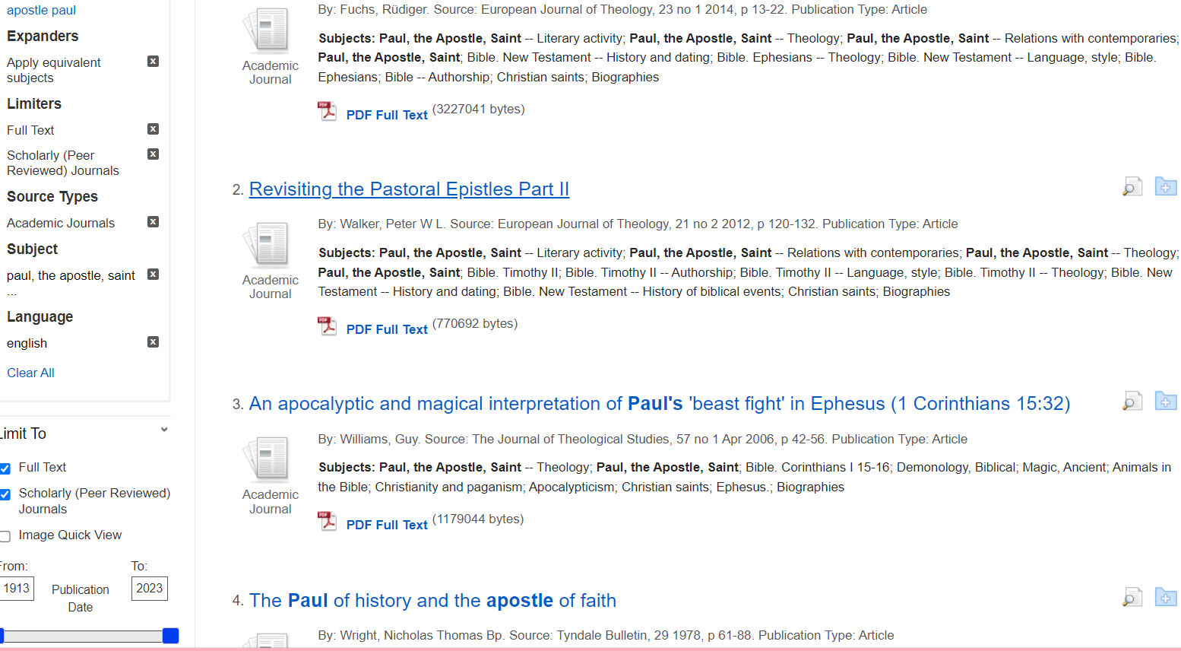
Refine your Search by Choosing the Limiters on the left

Slide 18
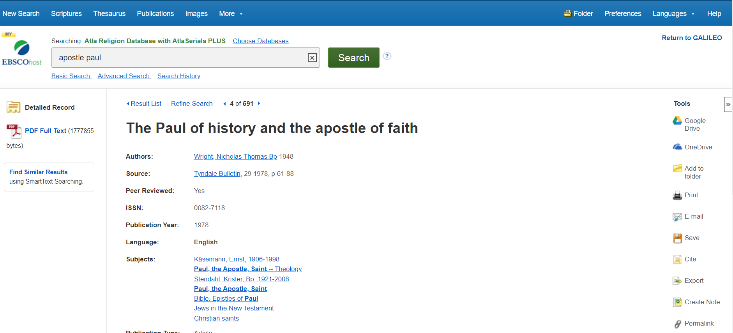
Click on the Fourth Result: The Paul of history and the apostle of faith

Slide 19
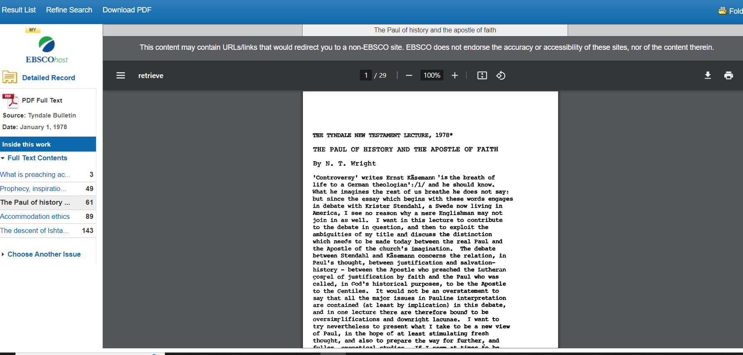
To View the full-text, click on the PDF on the left

Slide 20
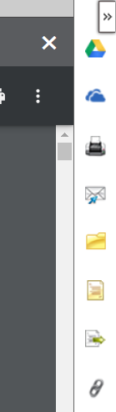
Options: Print, Save, Email, etc.

