Slide 1
Intro to Graduate Research
General Research and Search Strategies

Slide 2
Preliminary Steps
Selecting Your Topic- The first step in the research process is to choose a topic that fulfills a given assignment. Choose a topic that you feel enthusiastic about
Limit Your Topic-Initially for research purposes, just narrowing down your broad subject to a particular topic is enough.
Narrowing your topic- This can be done geographically, chronologically, or demographically.
Research Question- An investigation of a topic is not research until you have focused it around a solid question that addresses a problem or issue.

Slide 3
Planning Your Research
After you’ve determined your preliminary topic and research question, you should make a research plan by identifying the types of sources that will provide you with the information you need, determining where and how you will find these sources, and developing a time line for completing research tasks.

Slide 4
Types of Sources
Journal articles- The best way to find scholarly journal articles is to search your library’s online periodical databases rather than going straight to an internet search engine.
Print Books and E-Books- Books provide a depth of coverage unequaled by other formats.
Primary sources- Primary sources are first-hand sources directly related to an event
Other sources- government documents, conference papers, videos, podcasts, and so on.

Slide 5
How and Where to Find Sources
The best place to start your research is at your library’s website. The home page should provide access to the databases which are used to find articles e-Books, as well as the online catalog, which is used for finding books. Most library websites also provide guides (often called LibGuides after the popular software that is used to create them). These customized guides will help you determine the best resources for specific subject areas.

Slide 6
Evaluating Your Sources: Basic Questions to Ask Your Sources
What ideas or information does the source provide? Considering the content of a source is perhaps the most fundamental question. Does it answer your research questions?
Who wrote it? This question focuses on authority.
When was it written? The date that the source was published is a significant consideration for some topics.
Why was it written? This question considers the purpose of a resource.
How is it written? Evaluating the accuracy, style, and perspective of the author is crucial.

Slide 7
Fundamentals of Database Searching: Types of Databases
Periodical databases- A type of resource that is commonly available on library websites is the periodical database—a collection of records describing articles in magazines and journals. The information in these records will allow you to evaluate the sources found and determine whether or not you should read the full text, which is often just a click away.

Slide 8
Periodical Database Record
The way in which the information in an article is displayed will vary depending on which database you are using, but these records will provide similar information. Each type of information about the item is contained in a field. Fields include:
Article title (or headline, in the case of a newspaper article)
Author (staff-written articles might not specify an author)
Periodical Title (sometimes referred to as “the source”)
Issue, volume, date, and/or page numbers
Subject headings or terms (Specialized subject headings)
An abstract, which is a summary of the article

Slide 9
Online Catalogs
One type of database that all libraries have is an online catalog, which is a collection of information about the items owned by a particular library.

Slide 10
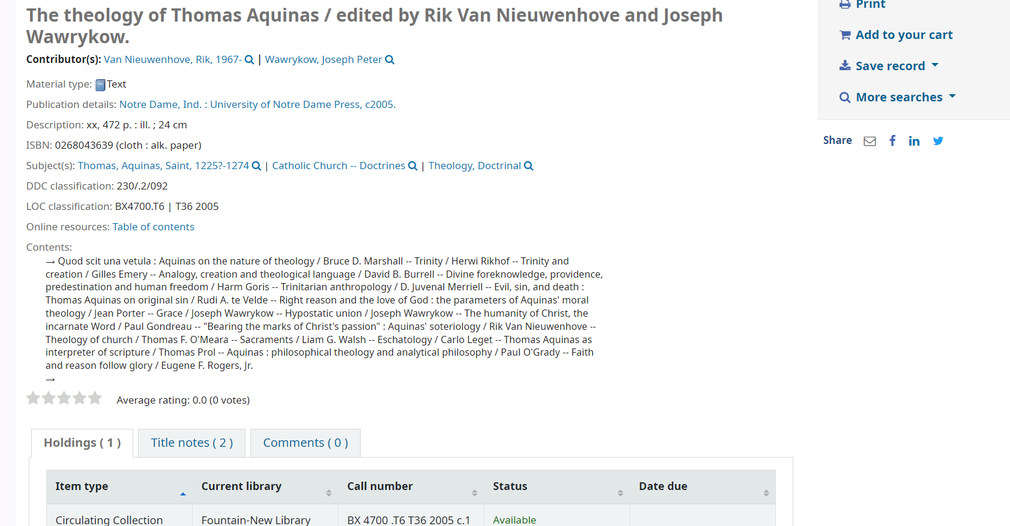
Sample record for a book from an online catalog

Slide 11
Online Catalog Record
The record for this book on the theology of Thomas Aquinas may look different in two different library catalogs, but the information provided will be essentially the same. There are fields for the author, title, publisher, and so on. If the item is a print book, the following essential information is given so that you can locate it in the library:
The call number, which indicates the book’s exact location.
The status, indicating whether the book is available or checked out.
The location is often given, especially in a library that might have special collections in addition to its general collection or at a large university that has multiple libraries.

Slide 12
Searching Databases
Keyword searching allows you to search for single words or phrases, as well as combinations of words and phrases, in just about any field. The principles discussed here form the basis of searching any computerized database and are actually even helpful for using internet search engines more effectively because the surface web can be only searched by keyword.

Slide 13
Keyword Searching
Unless you have a very general topic, you need to know how to do a keyword search for multiple keywords.
Keyword searching is invaluable for finding material on multi-disciplinary topics.
Keyword searching using more than one term or phrase is based on Boolean logic, which was developed by George Boole, a nineteenth century mathematician.
The Boolean operators are Or, And, and Not.

Slide 14
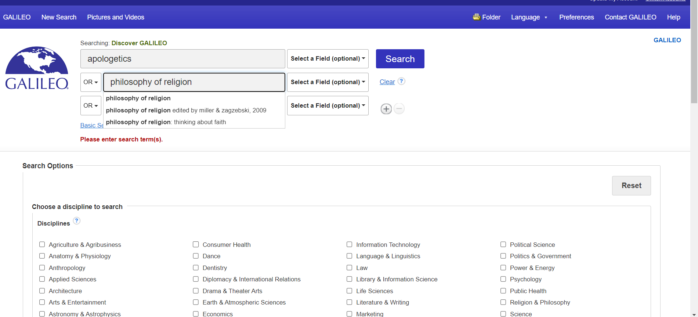
Keyword Searching Using Or

Slide 15
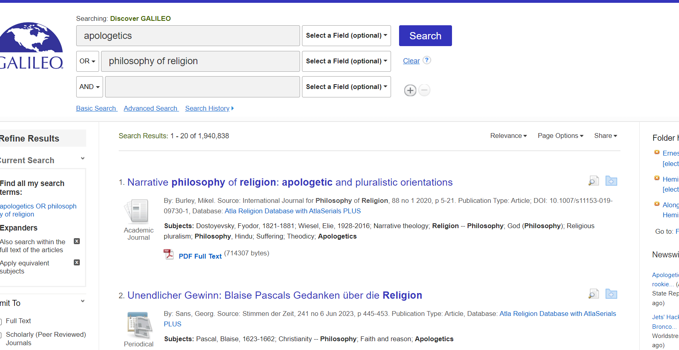
Search Results

Slide 16
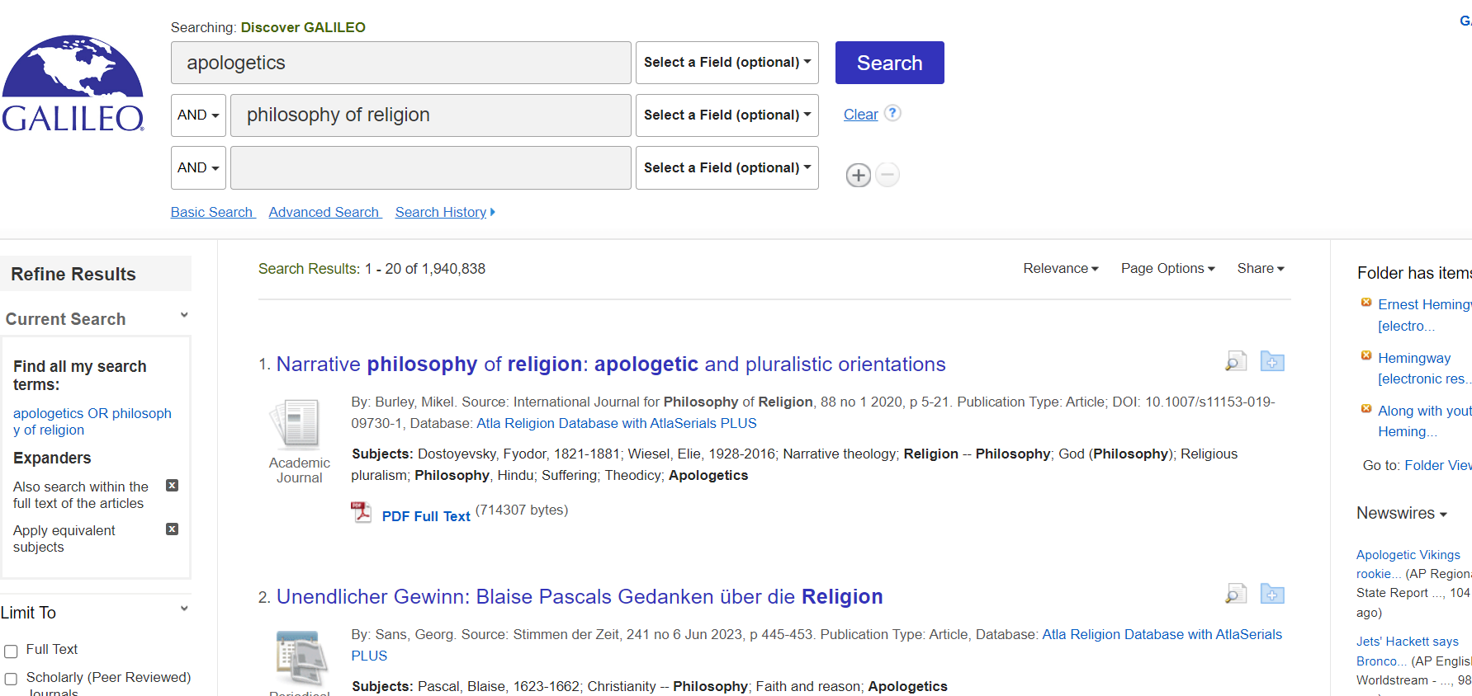
Keyword Searching Using AND

Slide 17
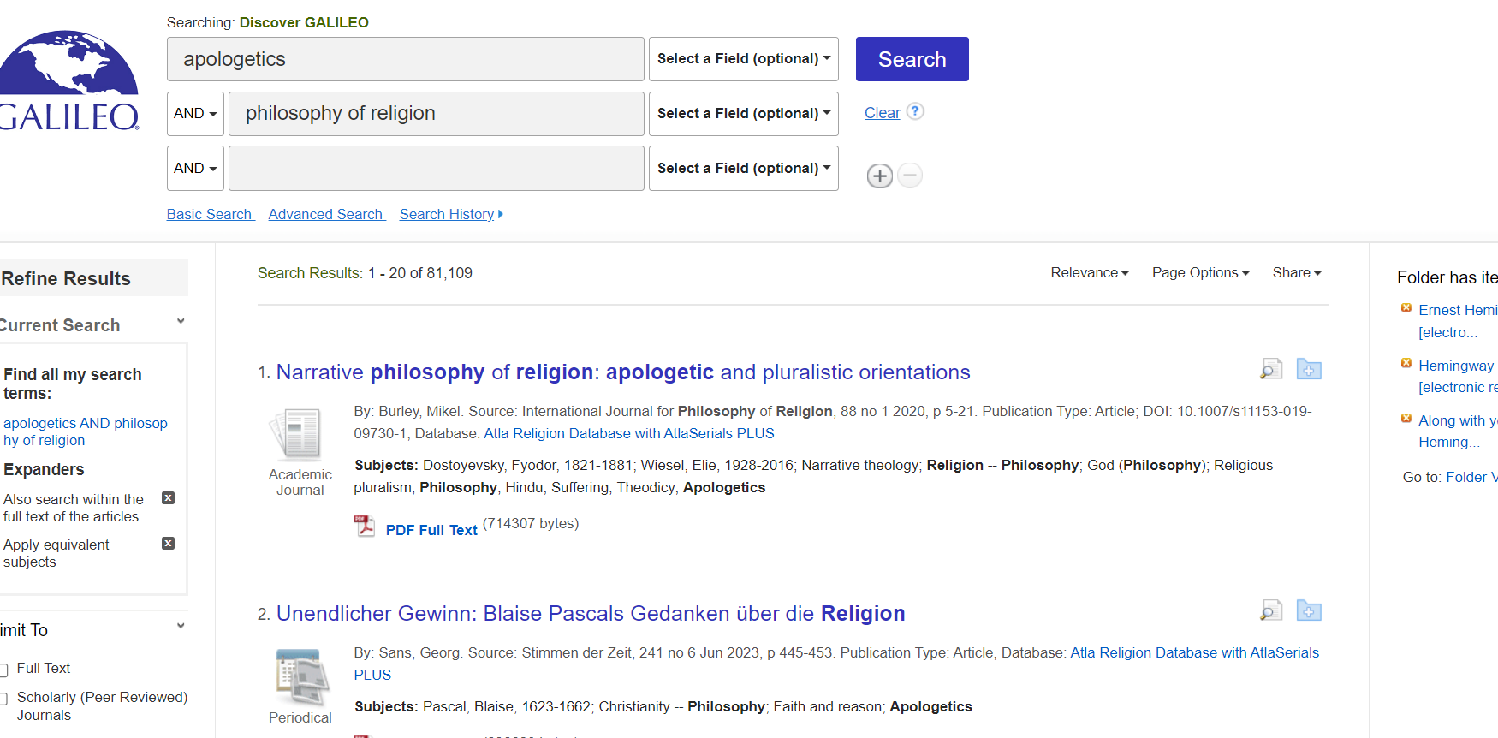
Results of Search

Slide 18
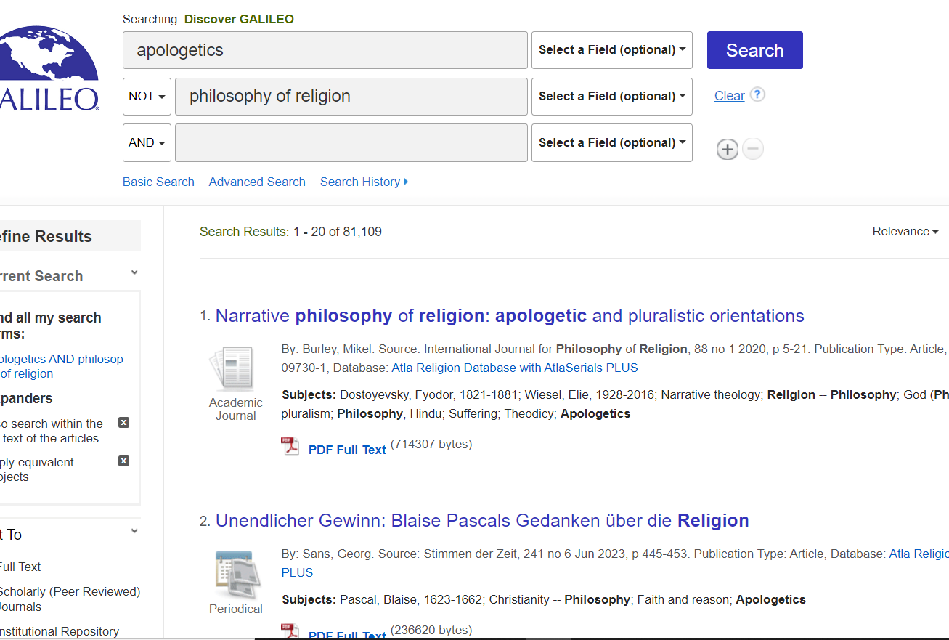
Keyword Searching Using Not

Slide 19
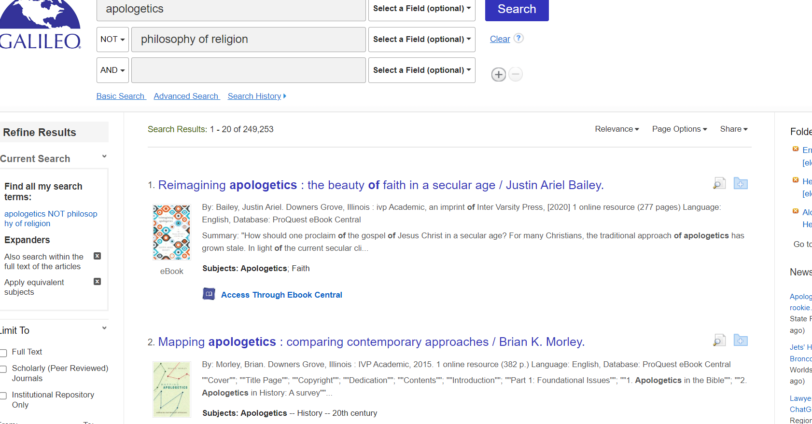
Results of the Search

Slide 20
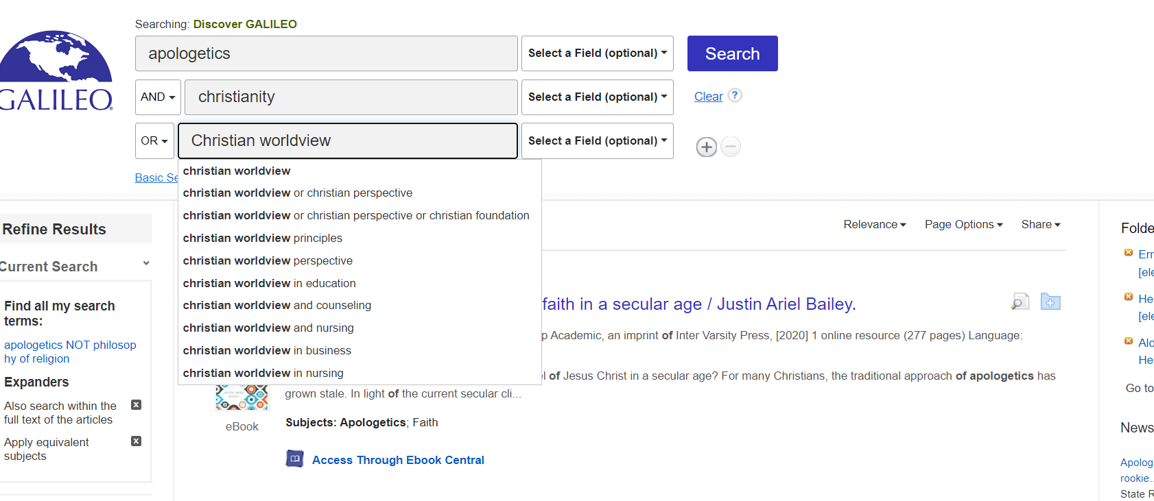
Combining the Operators

Slide 21
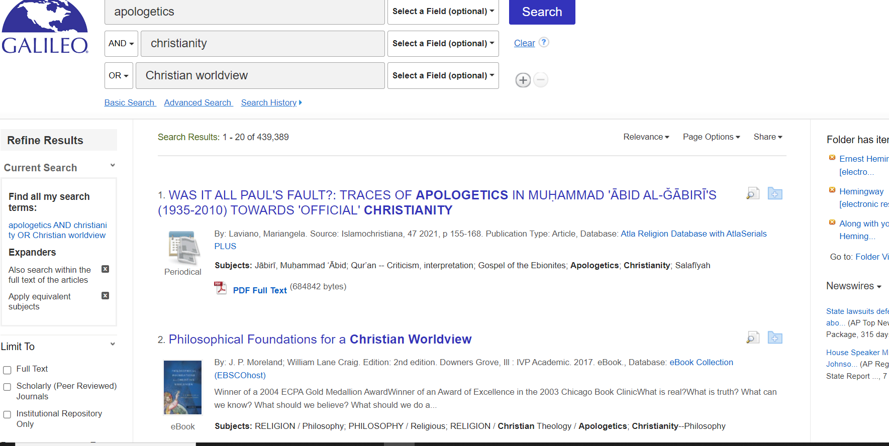
Search Results

